Slide 1
“Exploring contemporary evaluation methods Evaluation approaches and methods in practice”
4th PROFEEDBACK Training School, Budapest, 16-20 June 2025

Slide 2
Sessions 1 & 2
Dr. Marijana Sumpor
marisumpor@yahoo.com

Slide 3
Trainer: Dr. Marijana Sumpor
Experience:
2024- President of the Croatian Evaluation Society
2018- Director & consultant, Euro ekspertiza, Zagreb
2015 - EU Evaluation Helpdesk, Croatian contact
2015- Visiting lecturer at Faculty of Political Science, University of Zagreb
2001-2018 Researcher in regional policy, Institute of Economics, Zagreb
1998-2000 Credit risk manager, BNP-Dresdner Bank
1995-1998 Civil servant, Macroeconomics Department, Croatian Ministry of Finance
Education:
PhD (Regional development), University of Split &
PhD module in European Regional planning, University of Lille (2002)
1998 MSc (International trade), University of Zagreb
1995 BSc (Finance), University of Zagreb
Expertise:
Evaluation system development and capacity building
Strategic foresight & planning
Regional and local development (EU, national, regional, local level)

Slide 4
“Exploring contemporary evaluation methods Evaluation approaches and methods in practice”
Session 1 Theory-based evaluation (TBE) & reconstruction of the Theory of Change (ToC)
www.profeedback.eu • www.cost.eu • www.hetfa.eu

Slide 5
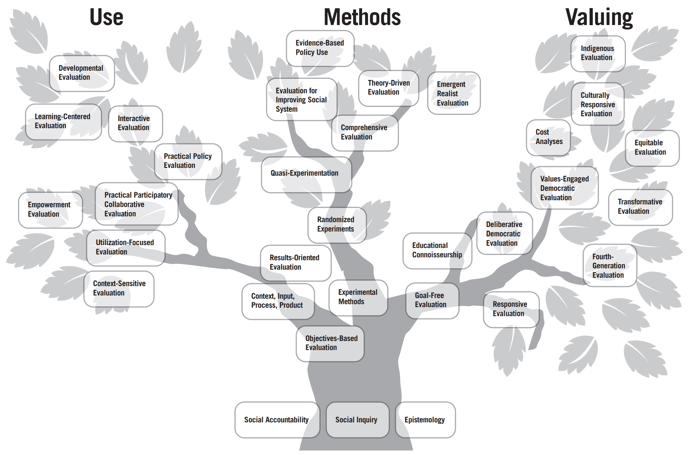
“Exploring contemporary evaluation methods Evaluation approaches and methods in practice”
The 3rd ed. of
The Evaluation Tree (Alkin and Christie, 2023)
Source:https://activeevaluator.com/evaluation-tree/
FOUNDATION OF EVALUATION
www.profeedback.eu • www.cost.eu • www.hetfa.eu

Slide 6
“Exploring contemporary evaluation methods Evaluation approaches and methods in practice”
www.profeedback.eu • www.cost.eu • www.hetfa.eu

Slide 7
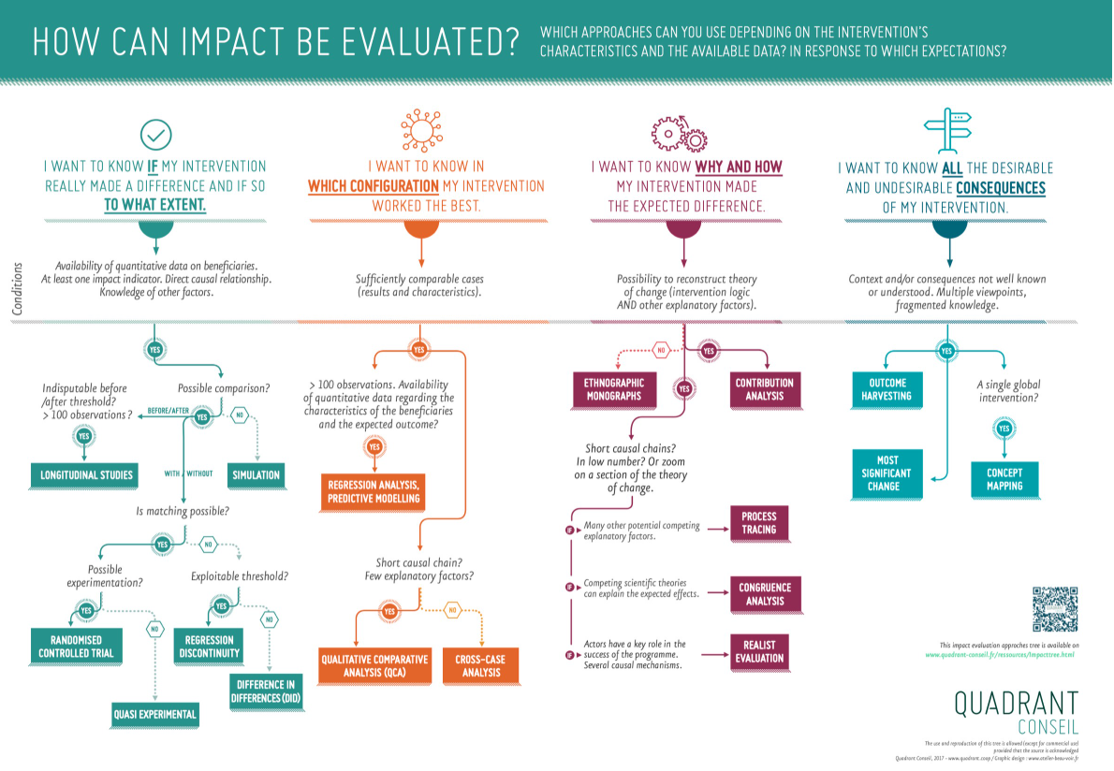
“Exploring contemporary evaluation methods Evaluation approaches and methods in practice”
QUADRANT CONSEIL’S
IMPACT TREE
https://www.quadrant-conseil.fr/ressources/impacttree.html
This tree is freely reusable (except for commercial use) provided that the source is acknowledged: "Quadrant Conseil, 2017 - www.quadrant.coop".
Graphic Design: Atelier Beau/Voir
www.profeedback.eu • www.cost.eu • www.hetfa.eu

Slide 8
“Exploring contemporary evaluation methods Evaluation approaches and methods in practice”
Theory based evaluation (TBE)
TBE is an approach to evaluation (i.e., a conceptual analytical model) and not a specific method or technique. It is a way of structuring and undertaking analysis in an evaluation.
A theory of change (TOC) explains how an intervention is expected to produce its results.
It starts with a sequence of events and results - outputs, immediate outcomes, intermediate outcomes and ultimate outcomes - that are expected to occur owing to the intervention - the logic model
Logic models are valuable tools for program planning, implementation, and evaluation across various sectors, including health, education, and community development. They help make the "theory of change" explicit, allowing for better understanding, communication, and ultimately, more effective programs.
www.profeedback.eu • www.cost.eu • www.hetfa.eu

Slide 9
“Exploring contemporary evaluation methods Evaluation approaches and methods in practice”
Theory based evaluation (TBE)
The TOC goes further by outlining the mechanisms of change, as well as the assumptions, risks and context that support or hinder the theory from being manifested as observed outcomes.
It allows evaluators to better examine the causal link between the intervention outputs and the observed outcomes.
It can be used to test with evidence the assumed causal chain of results with what is observed to have happened, checking each link and assumption in the process to verify the expected theory.
TOCs can be thought of as the story of what should happen in the “arrows” that link the boxes in a traditional logic model.
Another way to think of a TOC is as a logic model that has been described and explained in terms of the causal linkages between outputs and the different levels of outcome.
www.profeedback.eu • www.cost.eu • www.hetfa.eu

Slide 10
“Exploring contemporary evaluation methods Evaluation approaches and methods in practice”
Key Components of a Logic Model
Context: The situation, problem, or need the program addresses, and the overall goal.
Inputs: Resources, funding, staff, and other elements that are invested in the program.
Activities: The specific actions or processes that the program undertakes.
Outputs:
The direct results of the program's activities, often quantifiable (e.g., number of participants served, materials produced).
Outcomes: The changes or benefits that occur as a result of the program's activities and outputs, often categorized as short-term, mid-term, and long-term.
Impact: The long-term, broad societal or systemic changes that the program aims to contribute to.
www.profeedback.eu • www.cost.eu • www.hetfa.eu

Slide 11
“Exploring contemporary evaluation methods Evaluation approaches and methods in practice”
Realist evaluation
Realist Evaluation is a Theory-based method that focuses on understanding what works, for whom, in what circumstances, and why.
It seeks to uncover the underlying mechanisms that drive programme outcomes and how these mechanisms interact with different contexts.
The core idea is that interventions are not universally effective—they work differently depending on the context and how individuals respond to the opportunities provided.
Realist Evaluation can be conducted using a diverse array of data collection techniques, including qualitative methods such as interviews and case studies, as well as quantitative approaches like surveys.
www.profeedback.eu • www.cost.eu • www.hetfa.eu

Slide 12
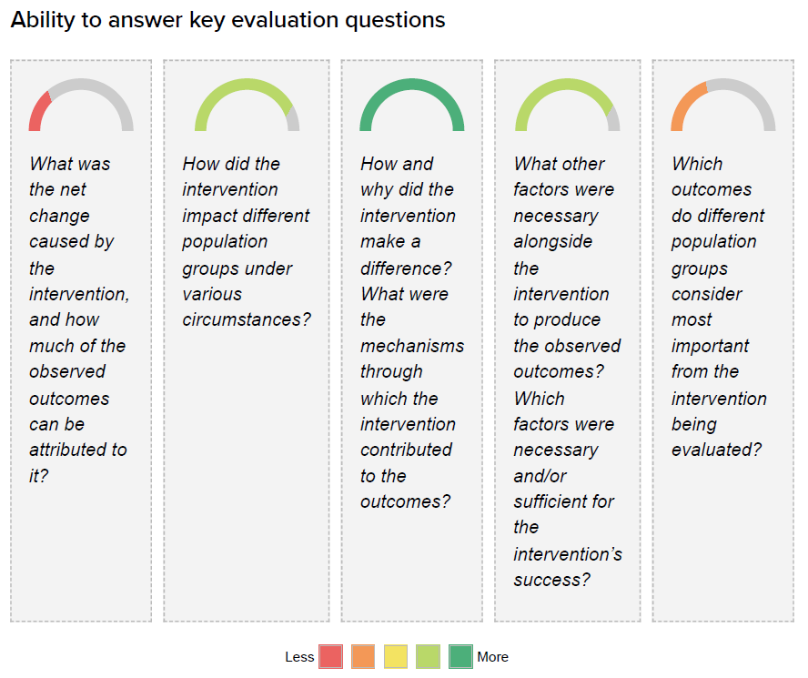
“Exploring contemporary evaluation methods Evaluation approaches and methods in practice”
www.profeedback.eu • www.cost.eu • www.hetfa.eu

Slide 13
“Exploring contemporary evaluation methods Evaluation approaches and methods in practice”
Realist Evaluation - key elements
Context-Mechanism-Outcome (CMO) configuration to explore how interventions operate: “In this Context (C), that particular mechanism (M) generates these outcomes (O).”
Context (C): The conditions, resources, opportunities, and constraints available to beneficiaries.
Mechanism (M): The reasoning, choices, or decisions individuals make based on there sources and opportunities in their context.
Outcome (O): The result of individuals’ behavior and choices influenced by the context and mechanisms.
Useful in situations where outcomes are closely tied to specific contextual conditions and require theorizing about how social mechanisms vary by context.
www.profeedback.eu • www.cost.eu • www.hetfa.eu

Slide 14
“Exploring contemporary evaluation methods Evaluation approaches and methods in practice”
Qualitative comparative analysis (QCA)
QCA is a Theory-based method for systematic cross-case comparison that identifies which factors or combinations of factors influence an outcome.
It bridges qualitative and quantitative traditions, incorporating the richness of case-based research while offering systematic rigor through its mathematical foundation.
www.profeedback.eu • www.cost.eu • www.hetfa.eu

Slide 15
“Exploring contemporary evaluation methods Evaluation approaches and methods in practice”
QCA key elements
Case-based and systematic: QCA analyzes cases (e.g., programmes or projects) as combinations—or “packages”—of characteristics (called conditions) suspected to influence outcomes. This approach retains the depth and complexity of qualitative methods while enabling generalization across cases.
Causal patterns: By comparing cases, QCA identifies the factors that consistently contribute to specific outcomes. It seeks to uncover necessary and sufficient conditions, as well as combinations of factors (known as “recipes”) that are most likely to lead to success.
Conceptualization: In its basic form (crisp-set QCA), both conditions and outcomes are categorized as either present or absent. This binary categorization simplifies the analysis of causal relationships.
www.profeedback.eu • www.cost.eu • www.hetfa.eu

Slide 16
“Exploring contemporary evaluation methods Evaluation approaches and methods in practice”
QCA key elements
Flexibility: unlike purely statistical methods, QCA does not require large datasets and is effective with a small to medium number of cases. However, it can also handle larger datasets.
Hybrid: QCA is often described as incorporating the “best of both worlds” by combining the rigor of quantitative methods with the depth of qualitative insights.
www.profeedback.eu • www.cost.eu • www.hetfa.eu

Slide 17
“Exploring contemporary evaluation methods Evaluation approaches and methods in practice”
Process Tracing
Process Tracing is a Theory-based method that helps evaluate causal mechanisms.
It is grounded in generative causality and takes a probabilistic approach to evidence.
The goal is to examine whether a causal mechanism or Theory of Change (ToC) is supported by evidence, building confidence in the existence (or absence) of its components.
www.profeedback.eu • www.cost.eu • www.hetfa.eu

Slide 18
“Exploring contemporary evaluation methods Evaluation approaches and methods in practice”
Process Tracing – key elements
Focus on causal explanation: Process Tracing aims to reconstruct the causal process that links an independent variable to an outcome. This could involve a Theory of Change, a complex mechanism, or a Context-Mechanism-Outcome (CMO) configuration.
A clear distinction among:
The process described in the Theory of Change, considered a possible 'reality' or an ontological entity that might or might not exist or have materialized (which is usually unobservable);
The evaluator's confidence about the existence of that reality (which is an idea 'in our head' rather than a reality 'out there');
The observable and therefore testable implications of the existence of such reality.
www.profeedback.eu • www.cost.eu • www.hetfa.eu

Slide 19
“Exploring contemporary evaluation methods Evaluation approaches and methods in practice”
Process Tracing – key elements
Backwards perspective: Process Tracing looks for “traces” left by the mechanism over time, using evidence to strengthen or weaken causal claims.
Types of evidence tests: Process Tracing uses four key metaphors to assess evidence:
Hoop Test: Evidence must exist for the claim to be valid, but it doesn’t confirm the claim alone.
Smoking Gun Test: Evidence strongly supports the claim but is not necessary for the claim to be true.
Straw-in-the-Wind Test: Evidence is weak but suggests the claim could be true.
Doubly-Decisive Test: Evidence strongly confirms the claim while ruling out alternatives.
Probabilistic Reasoning: Process Tracing evaluates the probative value of evidence, focusing on the likelihood of observing certain data if a causal mechanism is valid, versus if it is not.
www.profeedback.eu • www.cost.eu • www.hetfa.eu

Slide 20
“Exploring contemporary evaluation methods Evaluation approaches and methods in practice”
Contribution Analysis
Contribution Analysis is a Theory-based method used to examine and test a Theory of Change (ToC) by assessing its logic, the observed results, the underlying assumptions, and the role of other influencing factors.
It aims to reduce uncertainty about an intervention’s contribution to outcomes by providing a better understanding of why results occurred (or didn’t) and the roles played by the intervention and external factors.
www.profeedback.eu • www.cost.eu • www.hetfa.eu

Slide 21
“Exploring contemporary evaluation methods Evaluation approaches and methods in practice”
Contribution Analisis - key elements
Theory of Change as a framework: The ToC is central to CA and is visualized as a series of intermediate outcomes linked by assumptions and risks. Each step in the process relies on these assumptions holding true and risks being avoided for progress to the next stage.
Evidence-based verification: CA uses data to confirm whether the ToC aligns with reality or needs adjustment. This process strengthens the contribution claim by identifying gaps in logic, assumptions, or evidence.
Iterative approach: CA is iterative, often revisiting and refining the ToC and contribution story based on new evidence gathered during the intervention.
Focus on causal contribution: CA does not claim sole causation but instead explores the intervention’s role alongside other influencing factors.
www.profeedback.eu • www.cost.eu • www.hetfa.eu

Slide 22
“Exploring contemporary evaluation methods Evaluation approaches and methods in practice”
Contribution Analysis - steps
Define the cause-effect question: Clarify the issue to be addressed and the outcomes to analyze.
Develop the Theory of Change: Outline the hypothesized pathway from the intervention to the outcomes, including assumptions and risks.
Gather existing evidence: Collect data already available on the ToC and its assumptions.
Assess the contribution claim: Evaluate the evidence supporting the ToC and consider challenges to the claim.
Collect additional evidence: Gather new data from the intervention’s implementation to test the ToC further.
Strengthen the contribution story: Refine and reinforce the narrative about how the intervention contributed to the outcomes, addressing gaps and weaknesses.
www.profeedback.eu • www.cost.eu • www.hetfa.eu

Slide 23
“Exploring contemporary evaluation methods Evaluation approaches and methods in practice”
Theory of Change (ToC)
It is an approach to planning, learning, reflection and documentation of the change we make as development planners and practitioners.
It is a theory in the sense that it represents the best idea we have about how we can support changes AND we recognize that these ideas need to be constantly tested and refined so that we can have a stronger theory next time (which also need to be tested).
It explains why we think certain actions (a project, program and/or an organisational strategy) will likely lead to the desired change.
www.profeedback.eu • www.cost.eu • www.hetfa.eu

Slide 24
“Exploring contemporary evaluation methods Evaluation approaches and methods in practice”
ToC process
An on-going process of reflection to explore change and how it happens – and what that means for the part we play in a particular context, sector and/or group of people.
It considers a programme or project within a wider analysis of how change comes about
It makes us explain our understanding of change – but also challenges us to explore it further.
It is often presented in diagrammatic form with an accompanying narrative summary.
The focus is on what we think will change, not on what we plan to do.
www.profeedback.eu • www.cost.eu • www.hetfa.eu

Slide 25
“Exploring contemporary evaluation methods Evaluation approaches and methods in practice”
ToC preconditions
The building blocks of the change process.
These are conditions of states of being, that must be in place for the change process to be reached.
Preconditions must be achieved in order for the next logical task in the change pathway to be achieved.
www.profeedback.eu • www.cost.eu • www.hetfa.eu

Slide 26
“Exploring contemporary evaluation methods Evaluation approaches and methods in practice”
ToC pathways
A map that explains how we believe the long-term change are brought about by depicting the preconditions of change necessary to achieve the change.
The pathway of change (map indicating the link between the preconditions) is the skeleton on which other elements (assumptions and activities) are added.
The pathway summarizes the theory of an intervention - but does seldom tell the whole story.
www.profeedback.eu • www.cost.eu • www.hetfa.eu

Slide 27
“Exploring contemporary evaluation methods Evaluation approaches and methods in practice”
ToC Assumption
They explain why an intervention makes sense (in a given time).
It is something that is accepted as true or likely to happen.
They underpin our understanding of how change works, and why you believe that a sequence of changes will actually influence positive changes.
Being explicit about our assumptions also helps identify gaps and unmet needs, including additional necessary activities or actors that should be engaged.
www.profeedback.eu • www.cost.eu • www.hetfa.eu

Slide 28
OECD DAC Evaluation Criteria

Slide 29
“Exploring contemporary evaluation methods Evaluation approaches and methods in practice”
OECD DAC Evaluation Criteria
The OECD Development Assistance Committee (DAC) evaluation criteria are a set of standards used to assess the merit and worth of development interventions. These criteria help evaluators understand the effectiveness, efficiency, impact, relevance, coherence, and sustainability of development programs and policies.
These criteria are widely used in international development to ensure that evaluations are comprehensive, consistent, and useful for learning and accountability. They help development actors to understand what works, what doesn't, and why, ultimately contributing to more effective development efforts.
www.profeedback.eu • www.cost.eu • www.hetfa.eu

Slide 30
“Exploring contemporary evaluation methods Evaluation approaches and methods in practice”
OECD DAC Evaluation Criteria
Relevance: This assesses how well the intervention aligns with the needs of the target group, the priorities of the recipient country, and the goals of the donor. Essentially, is the intervention addressing the right problems and for the right people?
Effectiveness: This measures the extent to which the intervention achieves its intended objectives. It looks at whether the intervention is producing the desired results and whether these results are contributing to the overall development goals.
Efficiency: This evaluates how economically the intervention converts inputs (resources like funding, time, and personnel) into outputs (results). It asks whether the intervention is using the least costly resources possible to achieve its goals.
www.profeedback.eu • www.cost.eu • www.hetfa.eu

Slide 31
“Exploring contemporary evaluation methods Evaluation approaches and methods in practice”
OECD DAC Evaluation Criteria
Impact: This examines the positive and negative changes, both intended and unintended, that result from the intervention. It looks at the broader, longer-term effects on individuals, communities, and systems.
Sustainability: This assesses whether the benefits of the intervention are likely to continue after the intervention is completed and funding is withdrawn. It considers financial, institutional, and environmental factors that could affect the long-term viability of the intervention's results.
Coherence: This criterion examines how well the intervention aligns with other interventions and policies, both within and outside the development sector. It looks for synergies, complementarities, and potential conflicts with other initiatives.
www.profeedback.eu • www.cost.eu • www.hetfa.eu

Slide 32
“Exploring contemporary evaluation methods Evaluation approaches and methods in practice”
Session 2 Theory-based evaluation & Theory of Change: Realist evaluation - example of the EU Youth Policy
www.profeedback.eu • www.cost.eu • www.hetfa.eu

Slide 33
“Exploring contemporary evaluation methods Evaluation approaches and methods in practice”
Key Principles of Realist Evaluation
Programs work differently in different contexts: Realist evaluation assumes that outcomes are not just produced by programs themselves, but by the interaction between context (C), mechanism (M), and outcome (O)—often called CMO configurations.
Mechanisms are not the same as activities: A mechanism is the underlying reasoning or response of participants to the resources or opportunities a program offers. For example, a training session (activity) might work because it triggers confidence or motivation (mechanism).
Focus on causation: Instead of asking only "Did it work?", realist evaluators ask how and why something worked (or didn’t), considering the interplay of context and mechanisms.
www.profeedback.eu • www.cost.eu • www.hetfa.eu

Slide 34
“Exploring contemporary evaluation methods Evaluation approaches and methods in practice”
Steps in a Realist Evaluation
Clarify the program theory: What is the intervention supposed to do, and how? This involves articulating the assumed CMO configurations.
Design the evaluation: Choose methods (qualitative, quantitative, or mixed) to test the theory in different contexts.
Data collection and analysis: Collect data that helps you understand how mechanisms operate in particular contexts and produce outcomes.
Refine the theory: Update your program theory based on what you've learned about what works for whom and in what conditions.
www.profeedback.eu • www.cost.eu • www.hetfa.eu

Slide 35
“Exploring contemporary evaluation methods Evaluation approaches and methods in practice”
When to Use Realist Evaluation
In complex interventions with multiple stakeholders.
When traditional experimental methods (e.g., RCTs) don’t capture contextual variation.
When you want deeper insights into causality and implementation processes.
www.profeedback.eu • www.cost.eu • www.hetfa.eu

Slide 36
“Exploring contemporary evaluation methods Evaluation approaches and methods in practice”
Realist Evaluation of EU Youth Policy
Initial Program Theory: The EU Youth Policy supports young people’s social inclusion, education, and employment by providing opportunities for learning, mobility, civic engagement, and skill development.
Assumption: If young people are given resources and opportunities, they will become more empowered, employable, and socially active.
www.profeedback.eu • www.cost.eu • www.hetfa.eu

Slide 37
“Exploring contemporary evaluation methods Evaluation approaches and methods in practice”
EU Youth policy configurations
CMO 1 – Youth Empowerment through Participation
Context (C): Urban area with strong local youth organizations and infrastructure.
Mechanism (M): Youth feel heard, valued, and motivated to engage because of access to EU-funded youth forums and participatory processes.
Outcome (O): Increased civic engagement and youth-led initiatives.
CMO 2 – Employability through Erasmus+ Mobility
Context (C): Unemployed youth in rural areas with limited job opportunities.
Mechanism (M): Participation in Erasmus+ triggers confidence, international exposure, and skill development.
Outcome (O): Greater job readiness and employment opportunities (though may be limited by local job markets).
www.profeedback.eu • www.cost.eu • www.hetfa.eu

Slide 38
“Exploring contemporary evaluation methods Evaluation approaches and methods in practice”
EU Youth policy configurations
CMO 3 – Social Inclusion via Youth Guarantee
Context (C): Marginalized youth (e.g., NEETs – Not in Education, Employment, or Training) with limited trust in institutions.
Mechanism (M): One-on-one coaching builds trust and motivation to engage with education/employment.
Outcome (O): Increased uptake of education/training and long-term career planning.
www.profeedback.eu • www.cost.eu • www.hetfa.eu

Slide 39
“Exploring contemporary evaluation methods Evaluation approaches and methods in practice”
Evaluation Questions (Realist Style)
What aspects of the EU Youth Policy work best for which groups of youth, in which contexts, and why?
How do different mechanisms (e.g., motivation, empowerment, skill acquisition) contribute to outcomes like employment or civic participation?
Under what conditions do EU youth programs lead to unintended outcomes (e.g., brain drain, disengagement)?
www.profeedback.eu • www.cost.eu • www.hetfa.eu

Slide 40
“Exploring contemporary evaluation methods Evaluation approaches and methods in practice”
Data Collection Methods
Qualitative:
Interviews with youth participants, youth workers, and policymakers.
Focus groups in different EU regions.
Case studies of successful and unsuccessful initiatives.
Quantitative:
Surveys on employment status, civic engagement, or education outcomes.
Comparative analysis of program uptake and outcomes across different countries or regions.
www.profeedback.eu • www.cost.eu • www.hetfa.eu

Slide 41
“Exploring contemporary evaluation methods Evaluation approaches and methods in practice”
Refining the Theory
As dana is gathered, we may find that some mechanisms work only in certain contexts:
Example refinement: Civic engagement increases only when youth feel they can influence decisions and when there's local political support.
Adjust the theory to say: "EU programs work best in promoting youth participation when local governance is open and accessible."
www.profeedback.eu • www.cost.eu • www.hetfa.eu

Slide 42
“Exploring contemporary evaluation methods Evaluation approaches and methods in practice”
Realist Evaluation Plan: EU Youth Policy
Evaluation Title: “Understanding What Works in the EU Youth Policy: A Realist Evaluation of Youth Empowerment and Inclusion”.
Purpose of the Evaluation: To understand how and why EU Youth Policy initiatives (e.g., Erasmus+, Youth Guarantee, EU Youth Dialogue) contribute to youth empowerment, employability, and civic participation—for whom they work best, and under what circumstances.
Evaluation Objectives:
To identify key mechanisms through which EU Youth Policy interventions operate.
To explore how contextual factors influence outcomes.
To test and refine an initial program theory using CMO configurations.
To provide policy recommendations based on realist findings.
www.profeedback.eu • www.cost.eu • www.hetfa.eu

Slide 43
“Exploring contemporary evaluation methods Evaluation approaches and methods in practice”
Realist Evaluation Plan: EU Youth Policy
Initial Program Theory: The EU Youth Policy empowers young people by offering opportunities for education, mobility, participation, and support.
Theory: If young people are provided with tailored opportunities and support, they will become more socially included, employable, and civically engaged.
Research Questions (Realist-Style):
What are the key mechanisms that explain how EU Youth Policy initiatives achieve their intended outcomes?
In what contexts are these mechanisms activated or blocked?
What are the outcomes for different groups (e.g., rural youth, NEETs, migrants)?
How can programs be adapted to work better in diverse contexts?
www.profeedback.eu • www.cost.eu • www.hetfa.eu

Slide 44
“Exploring contemporary evaluation methods Evaluation approaches and methods in practice”
Methodology: Realist Evaluation Approach
Step 1: Elicit Initial Theory
Review EU policy documents, academic literature, and program logic models.
Conduct interviews with EU policymakers and youth program coordinators.
Step 3: Data Analysis
Use CMO coding to identify recurring Context-Mechanism-Outcome patterns.
Compare cases across different regions (e.g., urban vs. rural, different member states).
Step 2: Data Collection
Method | Target Group | Purpose
Semi-structured interviews | Youth participants | Understand mechanisms and personal experiences
Focus groups | Youth workers & NGOs | Explore context-specific challenges and successes
Document analysis | National Youth Plans, program reports | Map official goals vs. actual implementation
Surveys | Larger youth sample | Measure outcomes like empowerment, employment, participation
www.profeedback.eu • www.cost.eu • www.hetfa.eu

Slide 45
EXERCISE – Sort descriptions by Logic model components
Logic Model Components
Inputs
Activities
Outputs
Short-Term Outcomes
Medium-Term Outcomes
Long-Term Outcomes / Impacts
- Awareness campaigns and youth engagement initiatives | - Increased knowledge and skills (soft and technical) | - Number of youth participating in programs
- Creation of youth-led projects | - Increased youth representation in decision-making | - Policy frameworks (EU Youth Strategy, Youth Goals)
- EU funding (e.g. Erasmus+, Youth Guarantee) | - International mobility (Erasmus+ exchanges, volunteering) | - Reduced youth unemployment and NEET rates
- Greater access to employment, education, or training | - More inclusive, cohesive, and participatory societies in the EU | - Skills training & career support (e.g. Youth Guarantee)
- Improved awareness of civic rights and opportunities | - National/local co-funding | - Strengthened trust in public institutions
- Increased civic and democratic participation | - Number of events, workshops, exchanges | - Trained youth workers and facilitators
- Increased confidence, empowerment, and social connection | - Number of local/national policy proposals influenced by youth | - Youth organizations and NGOs
 |  | - Youth participation forums (e.g. EU Youth Dialogue)

Slide 46
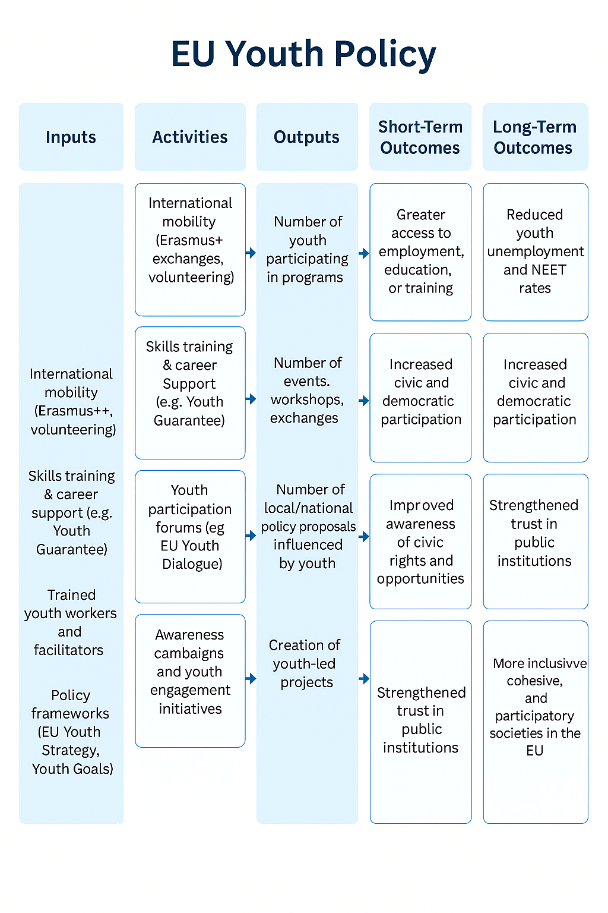
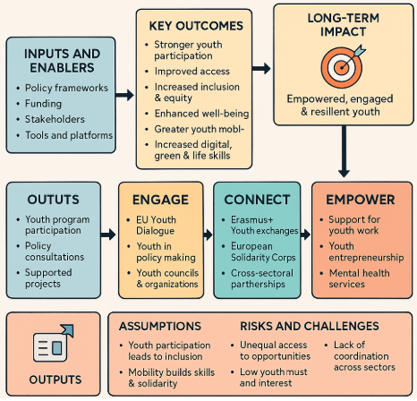
EU YOUTH POLICY
THEORY OF CHANGE VISUALISATIONS

Slide 47
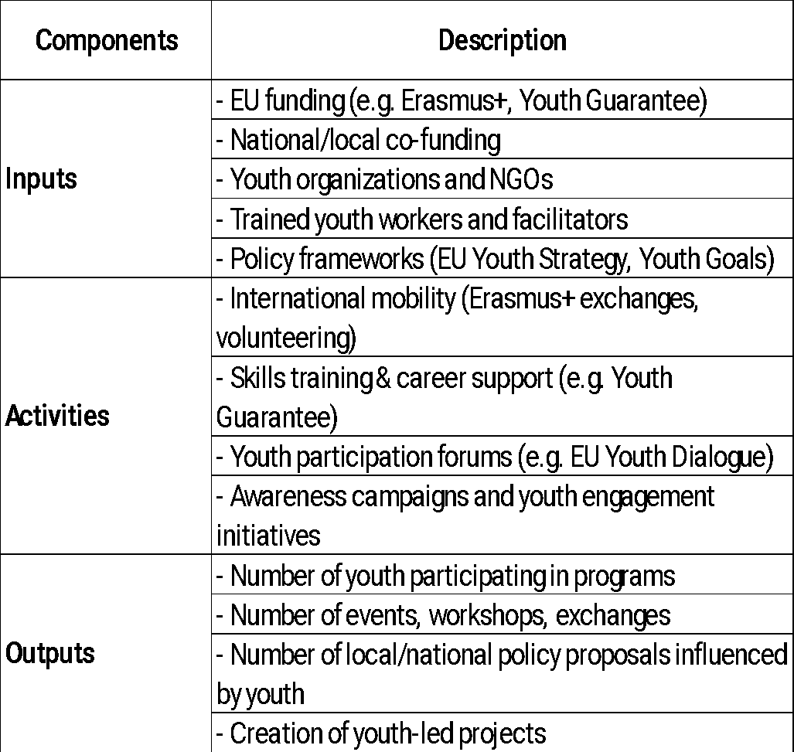
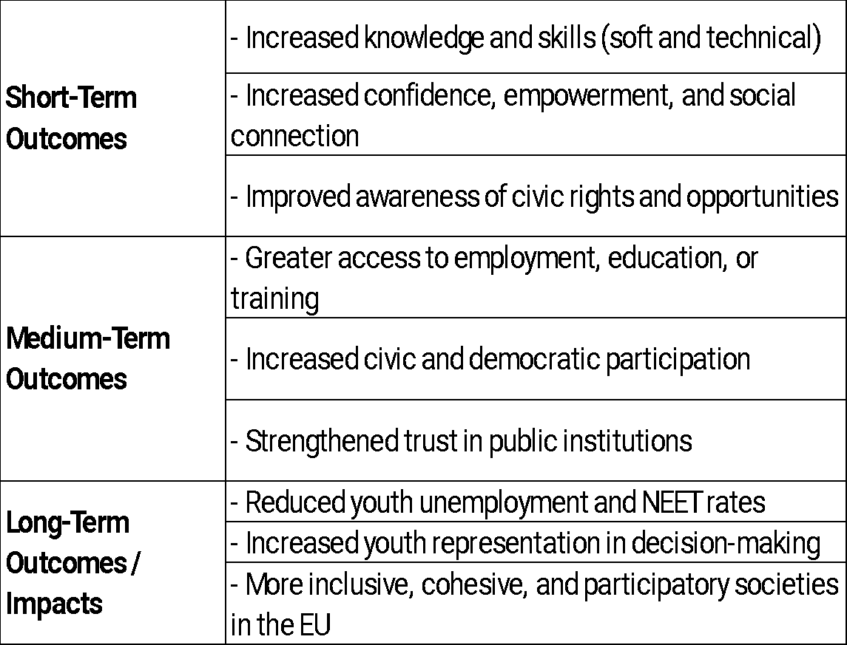
“Exploring contemporary evaluation methods Evaluation approaches and methods in practice”
www.profeedback.eu • www.cost.eu • www.hetfa.eu

Slide 48
“Exploring contemporary evaluation methods Evaluation approaches and methods in practice”
Literature & Sources
Alkin, M.C., & Christie, C.A. (Eds.). (2023). Evaluation roots: Theory influencing practice (3rd ed.). Gilford Publications.
Better Evaluation, Contribution Analysis, https://www.betterevaluation.org/methods-approaches/approaches/contribution-analysis
Government of Canada, Treasury Board of Canada Secretariat, (2012). Theory-Based Approaches to Evaluation: Concepts and Practices, From: https://www.canada.ca/en/treasury-board-secretariat/services/audit-evaluation/evaluation-government-canada/theory-based-approaches-evaluation-concepts-practices.html
Lemire, Sebastian. (2024). The Evaluation Metro Map. Journal of MultiDisciplinary Evaluation. 20. 35-40. 10.56645/jmde.v20i48.1063.
Quadrant Conseil, 2017, Evaluation Impact Tree, www.quadrant.coop.
UNDP, IEG, Realist Evaluation, https://erc.undp.org/methods-center/methods/evaluation-methods/realist-evaluation.
www.profeedback.eu • www.cost.eu • www.hetfa.eu

Slide 49
FOR MORE INFORMATION
profeedback.eu
BUDAPEST
16-20 JUNE 2025
Exploring contemporary evaluation methods Evaluation approaches and methods in practice
4TH PROFEEDBACK
TRAINING SCHOOL

