Slide 1
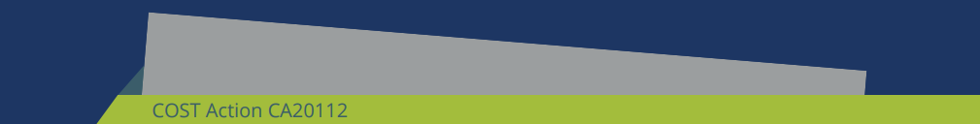


PROFEEDBACK
Exploring contemporary evalution methods, evaluation approaches and methods in practice
Training School
Budapest, 2025

Slide 2

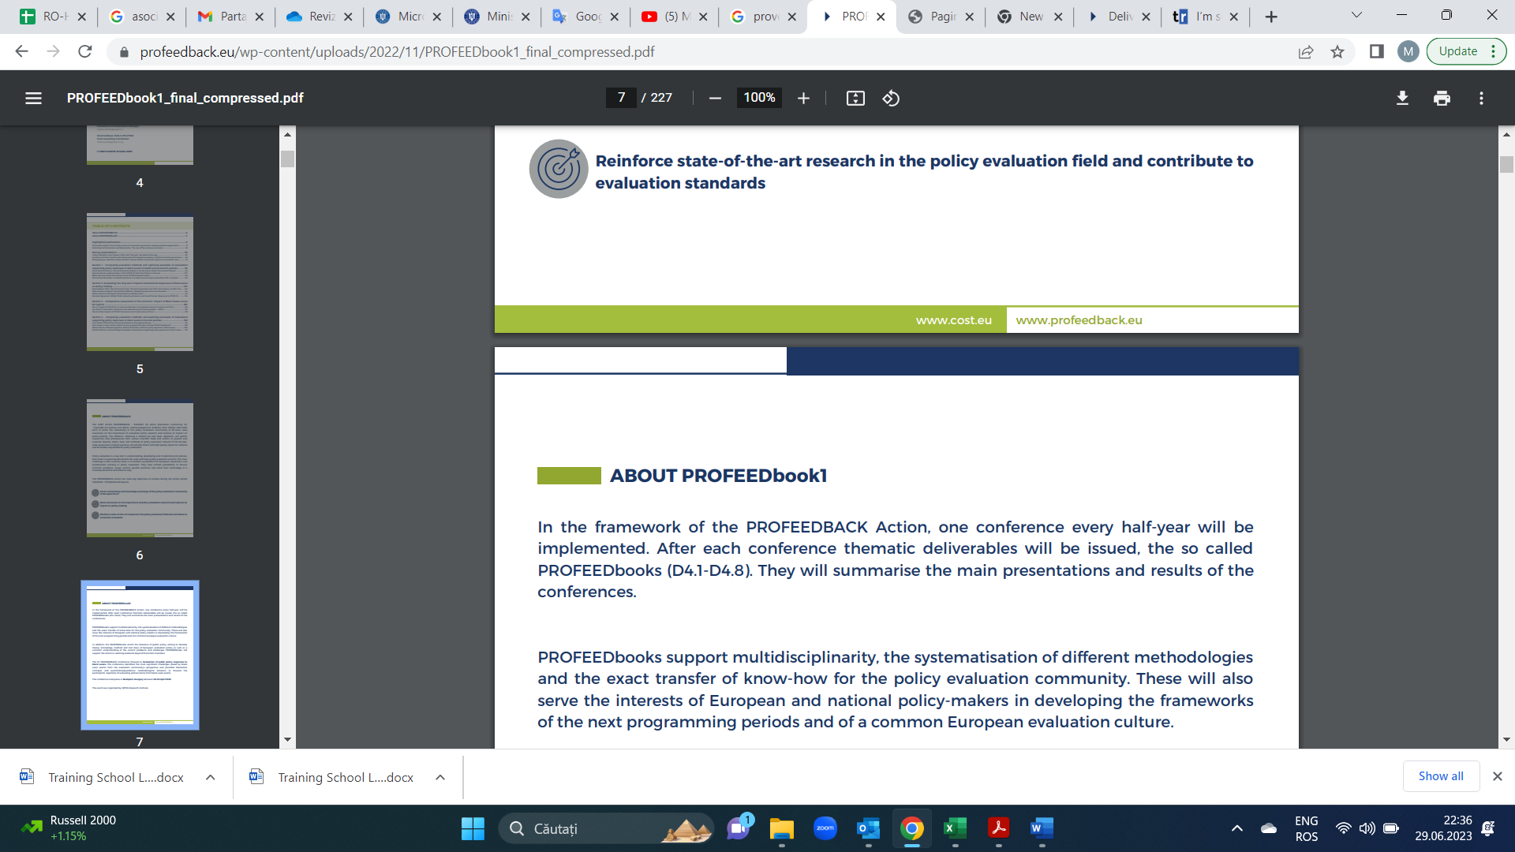
Trainer:
Sari Rannanpaa
Experience:
2023 - CEO, Senior Consultant, NordEval Oy
2023 - EU Policy Advisor, 4Front Oy
2019-2024 Visiting Lecturer, University of Akureyri
2018-2022 Lead Expert, MDI Public Oy
2013-2018 Evaluation Consultant, Avaintaito Osuuskunta
2009-2012 Policy Officer, European Commission
2003-2005 Civil servant, Finnish Ministry of Agriculture
Education:
2008 MPhil (Political Science), Central European University
2003 MA (Political Economy), University College London
2002 BSc (International Relations), London School of Economics and Political Science
Expertise:
Regional and rural development evaluation and research (EU, national, regional, local level),
Participatory methods,
Evaluation capacity building

Slide 3
Results chain

Slide 4
Results chain
A simple picture of what a programme / project is trying to achieve by showing the links between its intended outcomes (short, medium and long-term) and the inputs, activities and outputs required to achieve them.
Benefits:
  Makes assumptions explicit
  Identifies interim results.
  Defines how actions achieve results.
  Facilitates targeted monitoring and evaluation

Slide 5
Results chain
Resources needed to carry out activities
Actions taken to turn inputs into outputs
Concrete result of the programme
during the programme
Change in target group
at the end of the programme
Change in behaviour or performance
2-3 years after the programme
Change in programme area;
Programme only contributes;
5+ years after the programme
IMPLEMENTING PARTNERS
INTERMEDIARIES
BENEFICIARIES
SOCIETY
Inputs or means
Activities
Outputs
(products and services)
Immediate outcomes
Intermediate outcomes
Ultimate outcomes
IMPLEMENTING ORGANISATION
Management assumptions
Implementation assumptions
Development assumptions
Sustainability assumptions
Source: ITC-ILO

Slide 6
Example:
Results chain for Icelandic Fragile communities’ local grants for funding business ideas / start-ups by local people

Slide 7
Ultimate outcomes
The local economy is diversified, and the dependence on agriculture and fisheries as is reduced. The local economy grows.
Assumptions and risks
Assumptions: The start-up company will become a significant employer and economic entity locally. The general economic and demographic situation of the region/area supports economic growth.
Risks: Economic cycles, out-migration, external shocks to local economy (e.g. government decisions, large business closures)
Intermediate outcomes
The successful start-ups provide new or improved local products or services, which improves the local service provision. The start-ups also create new job opportunities in rural areas.
Assumptions and risks
Assumptions: The new goods or services produced by the company are interesting for customers and they are competitive in the market.
Risks: Access to finance, labour and knowledge/raw materials, entrepreneurs’ willingness to grow the company and employ external people
Immediate outcomes
The start-ups create new local products or services and employ the entrepreneur full-time.
Assumptions and risks
Assumptions: Supporting business ideas to sectors outside agriculture and fisheries from the local development grants leads to the establishment of a company locally. The newly established business will produce goods or services locally. The start-ups survive the initial start-up phase and become profitable enough to employ the entrepreneur full-time.
Risks: Entrepreneur knowledge, skills and resources, support for entrepreneurship, viability of the business plan, lack of demand for services or products
Outputs
The local grants for business ideas / start-ups by local people lead to new business start-ups outside agriculture and fisheries sectors in in rural areas

Slide 8
Main inputs or means
Main
Activities
Outputs
(products and services)
Immediate outcomes
Intermediate outcomes
Ultimate outcomes
Money: Icelandic crowns
Staff (FTE)
Local grants for business ideas / start-ups by local people
New business start-ups
New local products or services
Entrepreneur employed
Improved local services
New local jobs
Local economy diversified
Growth in local economy
Implementation assumptions
Development assumptions
Sustainability assumptions
Supporting business ideas to sectors outside agriculture and fisheries from the local development grants leads to the establishment of a company locally
The goods or services of the company are interesting for the customers and competitive
The company is able to grow (there is access to finance, labour and knowledge/raw materials)
The company will become a significant employer and economic entity locally
The general economic and demographic situation of the region/area supports economic growth

Slide 9
Evaluation approaches

Slide 10
Evaluation approaches
Distinct ways to think about, design, and conduct evaluations
No commonly agreed classification
Examples of various approaches
  Impact evaluation (=summative evaluation)
  Process evaluation
  Formative evaluation
    Developmental evaluation
    User-focused evaluation
  Participatory evaluation
  Theory-based evaluation

Slide 11
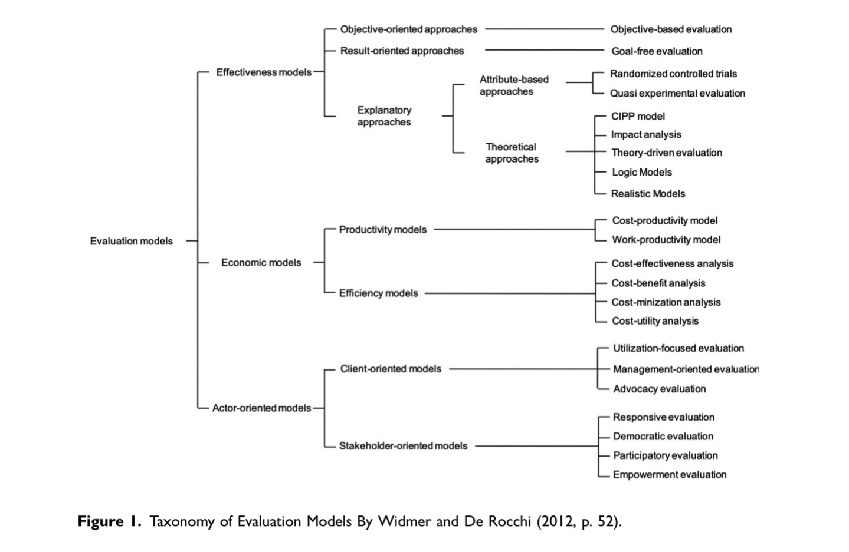

Slide 12
CONTRIBUTION OR ATTRIBUTION?
Measure X
Contribution: measure contributes to the change
Change
Measure X
Attribution: measure X causes the change
Change
X
X
Evaluated through qualitative methods
Evaluated through quantitative methods
Evaluated through quantitative means

Slide 13
Accounts of causation
Counterfactual causation (Lewis)
  Compares the real world with a fictitious one in which the intervention does not exist
Generative causation (e.g. Pawson & Tilley)
  Understands causality through causal mechanisms
  Causal outcomes follow from mechanisms acting in contexts
INUS causation (Mackie)
  Interacting causes produce an effect together rather than separately
  insufficient but necessary part of a condition which is itself unnecessary but sufficient for the result
Probabilistic causation (e.g. Mumford & Anjun)
  Causes increase the probability of effects, rather than deterministically causing them
Palenberg, M. Causal Claims in Contribution Analysis. 2023 Canadian Journal of Program Evaluation / La Revue canadienne d’évaluation de programme 37.3 (Special Issue / Numéro spécial), 389–402 doi: 10.3138/cjpe.75428

Slide 14
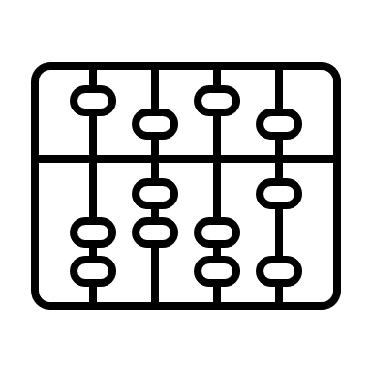

Evaluation approaches
Counterfactual (quantitative)
  What would have happened without the programme?
  Comparison groups
  Net effects (other factors removed)
Theory based
  Congruence of evidence with the Theory of Change
Eliminating alternative explanations
impact

Slide 15
Evaluation approaches and methods
Realist evaluation
Evaluation approaches
Theory-based
Mixed methods
QCA
Contribution analysis
Process tracing
Evaluation methods
Quantitative
Qualitative
Experimental
Survey
Case study
Randomised control
Quasi-experimental
Non-experimental
Interview
Matching methods
DID
Modelling
IV
Focus group
Face-to-face
PSM
CEM
RDD
GPSM
GEM
Synthetic control
13
Notes:
QCA: qualitative comparative analysis
CEM: coarsened exact matching
GEM: genetic exact matching
Mixed methods: http://betterevaluation.org/en/resources/guides/intro_mixed-methods_impact-evaluation
Mixed methods systematically integrate quantitative and qualitative methods and data

Slide 16
Source: HM Treasury, The Magenta Book

Slide 17
Contribution analysis

Slide 18
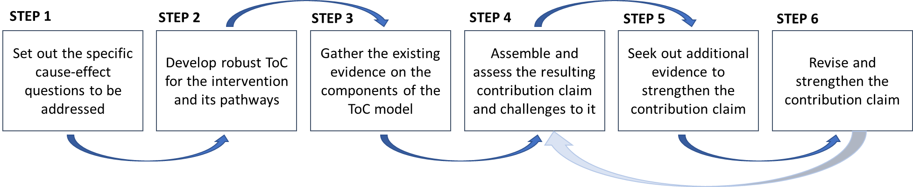
Contribution Analysis
Theory-based evaluation approach to evaluation of complex interventions
Helps to understand the likelihood that the intervention has contributed to an outcome observed, or not.
Employs a systematic approach (6 steps) in arriving at creditable causal claims either confirming postulated Theory of Change (ToC) or suggesting revisions to ToC where results prove otherwise.
Source: Mayne J (2001) Assessing attribution through contribution analysis: Using performance measures sensibly. The Canadian Journal of Program Evaluation 16: 1–2

Slide 19
Benefits of Contribution Analysis
Can prove causality in complex settings
Can demonstrate credible contribution to outcomes in cases where attribution is hard or inappropriate
Can account for multiple influencing factors
Permits qualitative and mixed methods
Structured but flexible
NB! Not suitable for answering questions related to efficiency or net impact.

Slide 20
Drawbacks of Contribution Analysis
Time-consuming and resource intensive
Resources used for CA depend on the complexity of the ToC
Requires significant input from the client in the beginning
Requires shared understanding (+manuals) within the team
  Sufficient evidence for accepting / refuting hypotheses
  Documentation of research and synthesis of evidence
Rigorous application required for credibility
  Operationalisation of evaluation has to include ToC and risks
  Iterations
Danger of over-estimating contribution of interventions

Slide 21
Specificities of Contribution Analysis
The aim is not to prove the effects of interventions, but to reduce uncertainty about their contribution to any changes that have occurred.
Contribution Analysis starts from the change to look for contributions, rather than from the intervention being evaluated.
Based on the idea that interventions do not intrinsically ‘work’; their success or failure always depends on a diversity of drivers and contexts, which the evaluation needs to document.
Organised around a process of
  developing a set of hypotheses about the effects of an intervention being evaluated (how these effects are achieved, in which cases, why...) - known as the 'theory of change’;
  testing these hypotheses through the collection and analysis of empirical information qualitative or mixed); and
  updating the original theory by indicating which hypotheses are verified.
Source: Delahais, T. Contribution analysis, LIEPP Methods Brief n°44, 2023-07

Slide 22
6 steps of Contribution Analysis

Slide 23
The Six Steps of Contribution Analysis
1. Set out the attribution problem
2. Develop the theory of change
3. Gather existing evidence
4. Assemble the contribution story
5. Seek out additional evidence
6. Revise and strengthen the contribution story
Delahais, T. Contribution Analysis. LIEPP Methods Brief n°44, 2023,

Slide 24
Step 1 – Define the attribution problem
What is the intervention to be examined?
What outcomes are to be examined?
What is the plausible attribution?
Concentrate on a few cause-and-effect questions
Specify these questions as precisely as possible in terms of
  scope (evaluated activities), and
  impact(s) to be assessed
Source: Delahais, T and Toulemonde, J. Applying contribution analysis: Lessons from five years of practice. Evaluation (2012) 18: 281

Slide 25
Step 2 – Theory of Change (ToC)
Build a Theory of Change
  From programme documents: inputs, activities, outputs, outcomes
  Documents, interviews: assumptions and risks
Assumptions: things that are necessary for the next step to happen
Risks: things that prevent the assumptions from realizing
  NB: risks should not be the flipside of assumptions!
Sufficient time and resources need to be invested into documentary review and exploratory stakeholder interviews
Watch out for narrow logic that can shape and bound the evaluation: there is a need for a systematic search for potential alternative explanations before gathering evidence
Source: Delahais, T and Toulemonde, J. Applying contribution analysis: Lessons from five years of practice. Evaluation (2012) 18: 281

Slide 26
Step 3 – Gather Evidence
Operationalise data and information collection in such a way that the ToC, risks, assumptions and hypotheses are included
Build up a data-collection work plan and apply a range of tools that enable the answering of each evaluation question on the basis of several distinct information sources
Apply the triangulation principle to each step of reasoning and not just to each evaluation question
Data and information collection:
  Existing reports, evaluations, monitoring data, project / programme documentation
  Interviews, surveys, stakeholder input

Slide 27
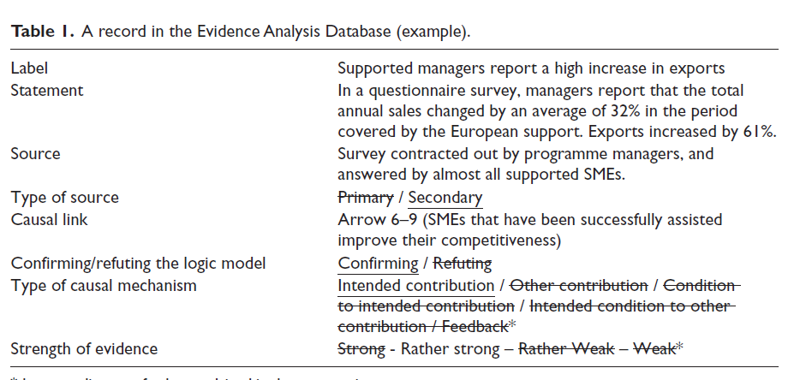
Example: Evidence Analysis Database
Source: Delahais, T and Toulemonde, J. Applying contribution analysis: Lessons from five years of practice. Evaluation (2012) 18: 281

Slide 28
Step 4 – Assemble Contribution Story
Contribution claim is a narrative that links intervention to outcomes
  Composed of a series of change statements and causal claims
  Describes the main causal mechanisms
  Assessment of collected data and information at the level of each causal link of the logic model
  Ordered along the boxes and arrows of the logic model
  Robustness depends on the supporting evidence
The claim is said to confirm the logic model if the intended change occurred and if the intended contribution is highly ranked in comparison with other contributing factors
Contribution claim asserts that an intended change
  did or did not occur
  due or not due to the intended contribution
  in conjunction with a few selected contextual factors
  all considered mechanisms being explained and ranked by order of influence, and
  other non-selected mechanisms being acknowledged.
Source: Delahais, T and Toulemonde, J. Applying contribution analysis: Lessons from five years of practice. Evaluation (2012) 18: 281

Slide 29
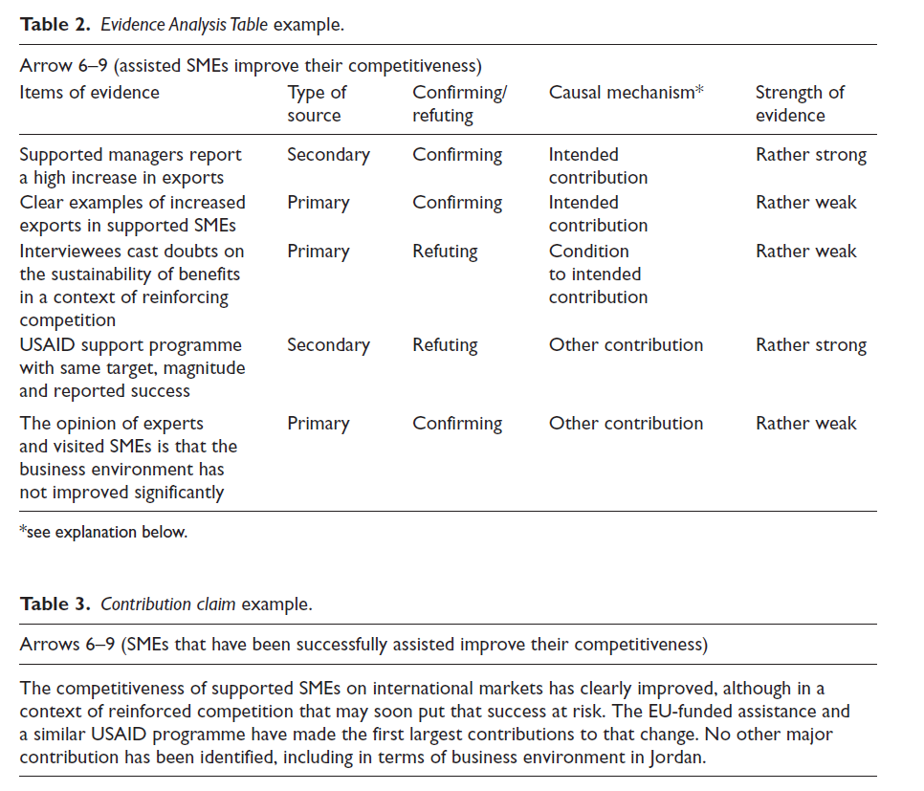
Source: Delahais, T and Toulemonde, J. Applying contribution analysis: Lessons from five years of practice. Evaluation (2012) 18: 281

Slide 30
Step 5 – Strengthen the Story
Review of the contribution story
  Quality assessment
  Comments from an external reader
  Discussion with the client / stakeholders
If there are issues where the contribution cannot be assesses, new evidence is needed to fill the gaps
Are there other explanations for the causal chain?
Test the contribution claims with the following questions:
  What is the evidence that the intervention contributed to these changes?
  What is the evidence that these changes are better explained by other drivers or by a combination of both the intervention and other drivers?

Slide 31
Step 6 – Revise and Validate
Reassess the contribution story
  Assess the strength of evidence
  Consider and the existence of alternative explanations
  Update the contribution story
This step can be repeated multiple times!
Share and validate with stakeholders
  E.g. 2-3 hour workshop (presentation & interactive discussions)

Slide 32
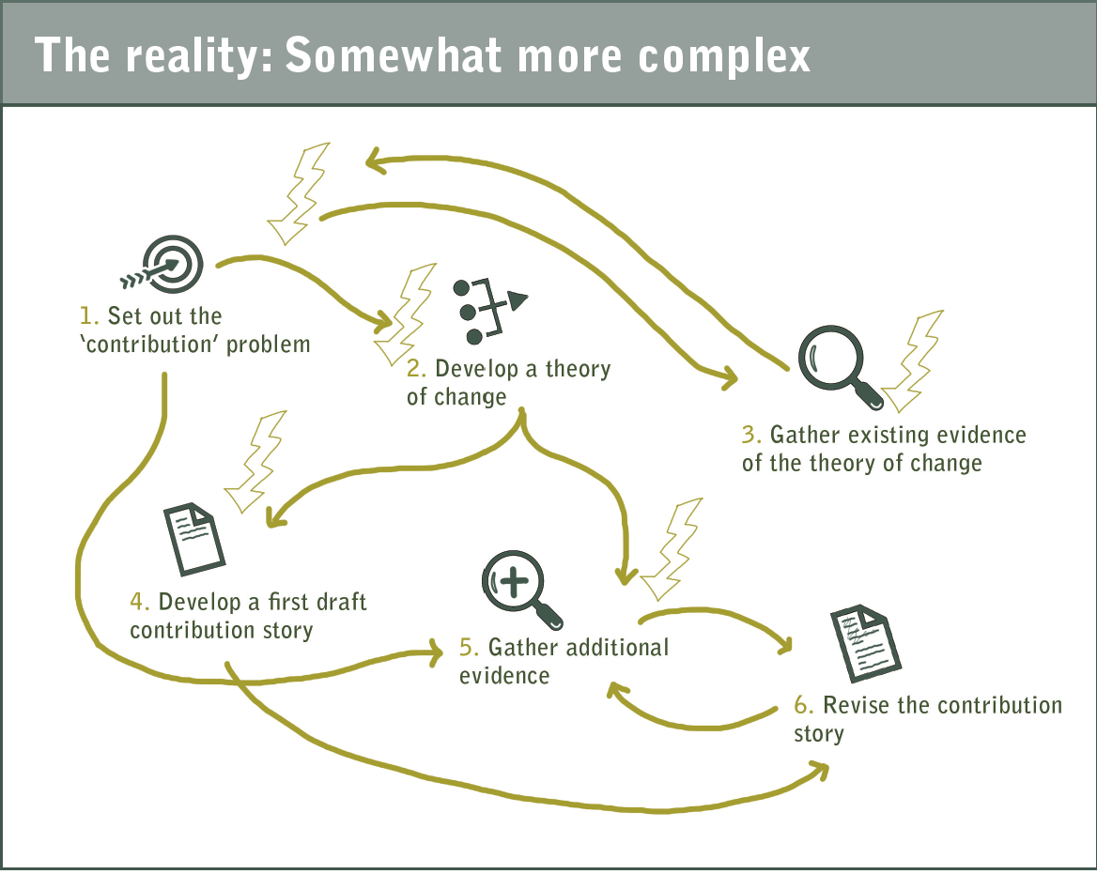
In practice….
Be prepared for
several iterations
non-linear project plan
additional data collection
regular stakeholder engagement
being critical to your own work and strength of the evidence
Laura Hopkins, Itad Ltd (2021). Tools and tips for implementing contribution analysis: A quick guide for practitioners.

Slide 33
Example
Ex Post Evaluation of the Interreg Central Baltic 2014-2020 Programme

Slide 34
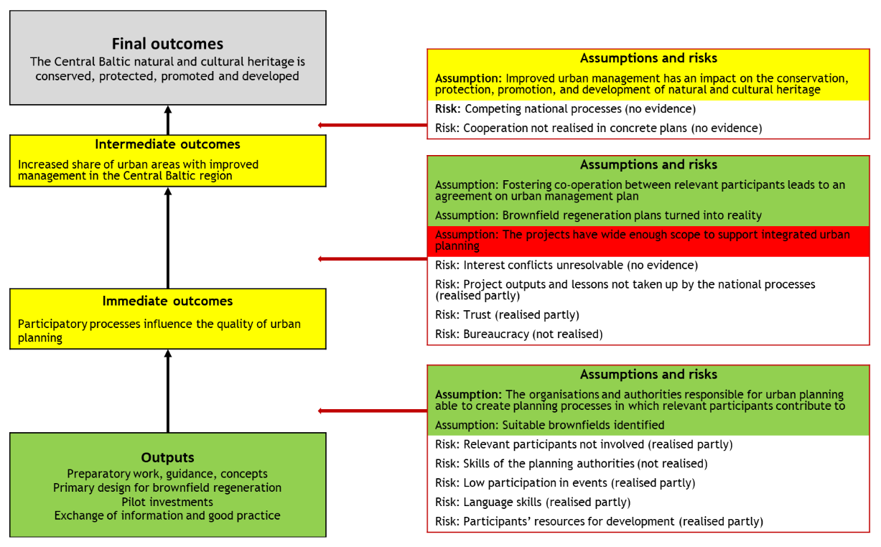
Example: Contribution analysis
Specific Objective 2.3 Better urban planning in the Central Baltic region
GREEN: supporting evidence was identified confirming a change or assumption fully realised
YELLOW: both supporting and refuting evidence was identified for expected change or an assumption being relised
RED: supporting evidence was identified disproving the expected change or an assumption was not realised
GRAY: no or very little evidence was identified
Source: Ex Post Evaluation of the Interreg Central Baltic Programme 2014-2020 (2023)

Slide 35
Excercise
Work on the basis of the Theory of Change developed in the previous exercise
TASKS
Define the attribution problem to be examined
Visualise the Theory of Change in boxes
Develop assumptions and risks
Develop a draft causal claims
Plan data and information collection

Slide 36
Final outcomes
Assumptions and risks
Intermediate outcomes
Assumptions and risks
Immediate outcomes
Assumptions and risks
Outputs

Slide 37
Further Reading
Qualitative Research Methods in Program Evaluation: Considerations for Federal Staff (2016): https://www.acf.hhs.gov/sites/default/files/acyf/qualitative_research_methods_in_program_evaluation.pdf
Treasury Board of Canada, Theory-Based Approaches to Evaluation: Concepts and Practices (2012) https://www.canada.ca/en/treasury-board-secretariat/services/audit-evaluation/centre-excellence-evaluation/theory-based-approaches-evaluation-concepts-practices.html
Mayne, J (2001). ‘Addressing Attribution through Contribution Analysis: Using Performance Measures Sensibly’, Canadian Journal of Program Evaluation 16.1: 1–24
Mayne, J (2008). Contribution Analysis: An approach to exploring cause and effect. Brief 16, Institutional Learning and Change (ILAC) Initiative
Mayne, J (2012a). Making Causal Claims. Brief 26, Institutional Learning and Change (ILAC) Initiative
Mayne, J (2012b). ‘Special Issue: Contribution Analysis’, Evaluation 18.3
Mayne, J (2020). A brief on contribution analysis. Principles and concepts. https://evaluatingadvocacy.org/doc/A-brief-on-contribution-analysis-Principles-and-concepts.pdf

