Slide 1
PROFEEDBACK Exploring contemporary evaluation methods, evaluation approaches and methods in practice Training School
Budapest, 2025

Slide 2
Evaluation approaches and methods
Realist evaluation
Evaluation approaches
Theory-based
Mixed methods
QCA
Contribution analysis
Process tracing
Evaluation methods
Quantitative
Qualitative
Experimental
Survey
Case study
Randomised control
Quasi-
experimental
Non-experimental
Interview
Matching methods
DID
Modelling
IV
Focus group
Face-to-face
PSM
CEM
RDD
GPSM
GEM
Synthetic control
13
Notes:
QCA: qualitative comparative analysis
CEM: coarsened exact matching
GEM: genetic exact matching
Mixed methods: http://betterevaluation.org/en/resources/guides/intro_mixed-methods_impact-evaluation
Mixed methods systematically integrate quantitative and qualitative methods and data

Slide 3
Process tracing

Slide 4
Process tracing
The main purpose of process tracing is to establish whether, and how, a potential cause or causes influenced a specified change or set of changes. This is done by applying formal tests to examine the strength of evidence linking potential causes to the changes.
Process tracing = tracing 'how change happens’
Emphasizes the explicit connections between actors, their actions, and resulting behavioral changes
Qualitative method to trace causal mechanisms in individual cases
Focus on within-case causal inference
Based on evidence-based reasoning
Tests causal paths (Theory of Change)
Complements other methods
Employs Bayesian logic

Slide 5
Benefits of Process tracing
Rich causal understanding
Tests rival explanations
Assumptions are documented
Complements quantitative methods
Useful for evaluating how intangible interventions, such as knowledge work and institution building, have contributed to outcomes

Slide 6
Limitations of Process tracing
Time-consuming and resource intensive
Requires solid theory
Limited generalizability
The robustness of process-tracing findings, however, critically depends on how well theory and empirical observables come together.

Slide 7
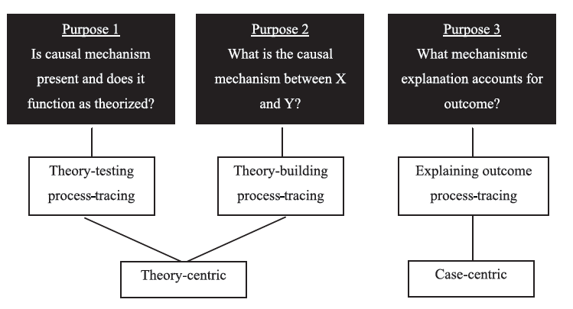
Different uses of process tracing
Beach, D., and Pedersen, R. 2013. Process-Tracing Methods. Ann Arbor: University of Michigan Press.

Slide 8
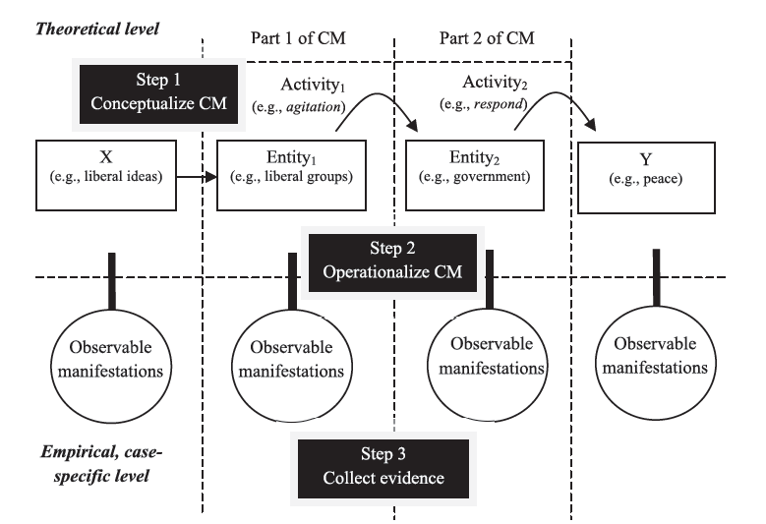
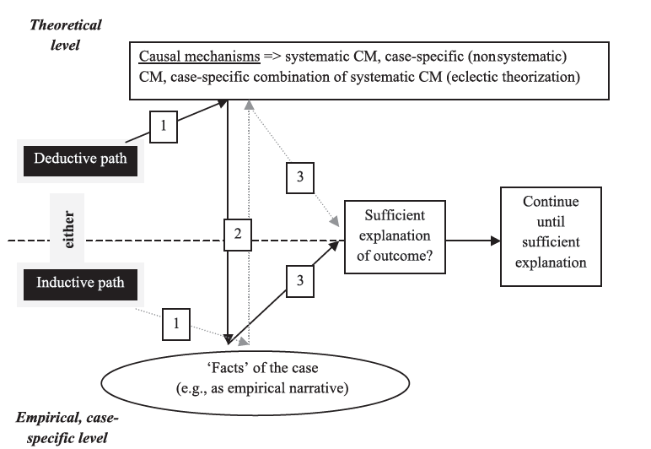
…imply different designs
Theory-testing
Explaining outcome
Beach, D., and Pedersen, R. 2013. Process-Tracing Methods. Ann Arbor: University of Michigan Press.

Slide 9
Process tracing in practice

Slide 10
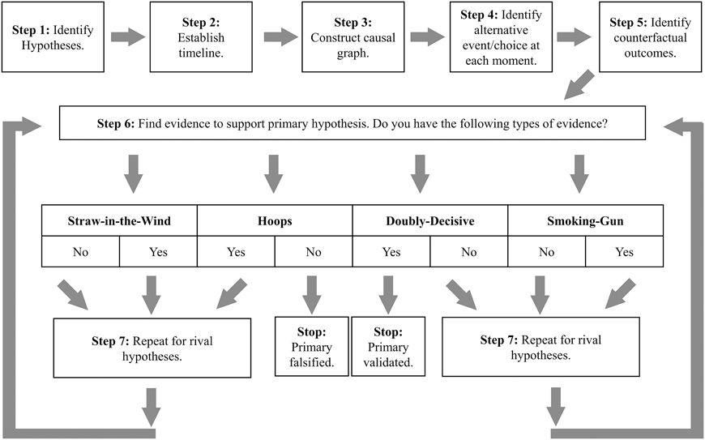
Steps of process tracing
Ricks & Liu (2018)

Slide 11
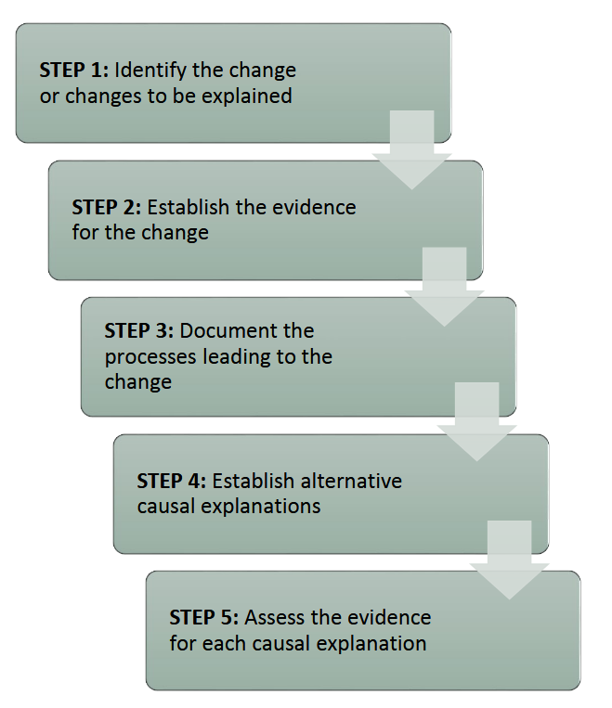
Steps of process tracing
Theorising How Interventions Produce Outcomes
Tracing a Process Theory of Change Empirically
Learning Lessons From Process Tracing Case Studies
Descriptive analysis of what happened during an Intervention
Operationalization of Expected Observables
Case Selection
Initial Exploration of how the contribution could have been produced
Details of the Inner Workings of the Intervention
Fieldwork to Test and Revise the Initial Process Theory of Change
Disaggregation of the Process Theory of Change
Knowledge of Contextual Factors
INTRAC (2017)
Beach & Raimondo 2025

Slide 12
Components of process tracing
As an evaluation method, process tracing has three components:
a “process” theory, which is a granular causal theory that links an intervention and contribution through a process theory of change (pToC) that models, theoretically, the sequence of interactions between a particular policy or program intervention and a particular contribution to a policy or program outcome;
“tracing” of the pToC by assessing empirical observables produced by the activities and links in the process; and
drawing of more general lessons from the cases studied by identifying why the intervention worked in those cases and what contextual factors need to be present for it to work in analogous ways in other cases.
Source: Beach, Derek, and Estelle Raimondo. 2025. Process-Tracing Methods in Program Evaluation. IEG Methods and Evaluation Capacity Development Working Paper Series. Independent Evaluation Group. World Bank

Slide 13
ToC vs pToC
Theory of Change
Process Theory of Change
describes, in terms of assumptions, the causal links between the inputs to and activities of a project and the outputs from and outcomes and impacts of the project
tends to depict interventions in snapshot form, describing inputs and activities followed by outputs and outcomes
tries to break down each of the links into a set of activities and interactions that illustrate the actual behavioral link between an input and an output
offers a more dynamic picture that breaks down the interactions between program actors and beneficiaries into a series of episodes
Source: Beach, Derek, and Estelle Raimondo. 2025. Process-Tracing Methods in Program Evaluation. IEG Methods and Evaluation Capacity Development Working Paper Series. Independent Evaluation Group. World Bank

Slide 14
pToC
A good pToC includes only the key episodes of interaction that link the actions of program actors and those affected by these actions in a causal sequence that produces one or more contributions to program or policy outcomes
These episodes in a causal process are also known as causal hotspots
To identify key episodes, evaluators must ask themselves which interactions have been critical in enabling actors to overcome challenges and barriers that otherwise would have stood in the way of achieving the change the program or policy intended to accomplish
Source: Beach, Derek, and Estelle Raimondo. 2025. Process-Tracing Methods in Program Evaluation. IEG Methods and Evaluation Capacity Development Working Paper Series. Independent Evaluation Group. World Bank

Slide 15
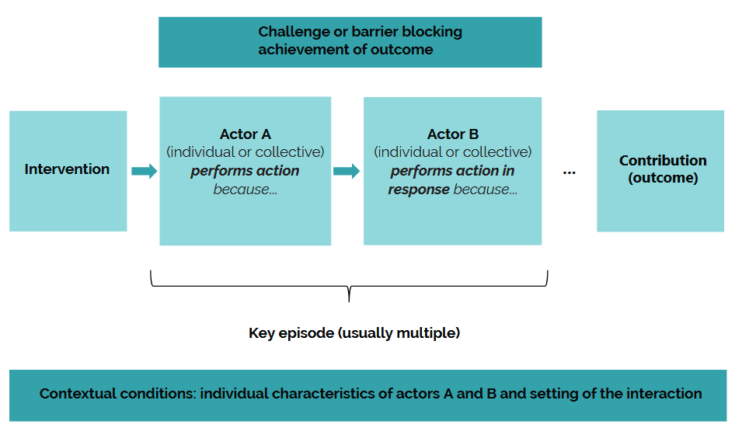
Source: Beach, D., and Raimondo, E. 2025. Process-Tracing Methods in Program Evaluation. IEG Methods and Evaluation Capacity Development Working Paper Series. Independent Evaluation Group. World Bank

Slide 16
Steps in Process Tracing: Developing a pToC
Descriptive analysis of what happened, identifying what activities were associated with the intervention and what potential contributions to the final policy or program outcome each activity might have produced;
Initial exploration of how each contribution to the final outcome might have been plausibly produced, including identification of key episodes;
Disaggregation of the pToC into episodes of interaction between actors.
Source: Beach, D., and Raimondo, E. 2025. Process-Tracing Methods in Program Evaluation. IEG Methods and Evaluation Capacity Development Working Paper Series. Independent Evaluation Group. World Bank

Slide 17
Steps in Process Tracing: Tracing
Operationalisation of expected observables
What should we find? What kind of evidence would be needed for yes/no?
Need-to-find evidence = disconfirmatory evidence
Love-to-find evidence = confirmatory evidence
Operationalisation of data and information collection
Interviews, surveys, attendance logs, minutes, social media
Fieldwork to Test and Revise the Initial Process Theory of Change
Triangulation across sources
Organisation of data and information
Mechanism diagrams
Evidence matrices
Coding frameworks
Modified from Beach & Raimondo 2025

Slide 18
Evaluating the collected evidence
Straw-in-the-wind tests:
Evidence that is neither unique nor certain. Passing this test only weakly supports the hypothesis but doesn't eliminate other possibilities.
Hoop tests:
Evidence that is necessary (a "hoop" that must be jumped through) but not sufficient to confirm the hypothesis. If the evidence fails this test, the hypothesis can be eliminated.
Smoking gun tests:
Evidence that is unique and strongly supports the hypothesis but doesn't eliminate other potential explanations.
Doubly decisive tests:
Evidence that is both unique and certain, meaning it strongly confirms the hypothesis and eliminates rival explanations.

Slide 19
Simister, N and Scholz, V. Process tracing. INTRAC (2017)

Slide 20
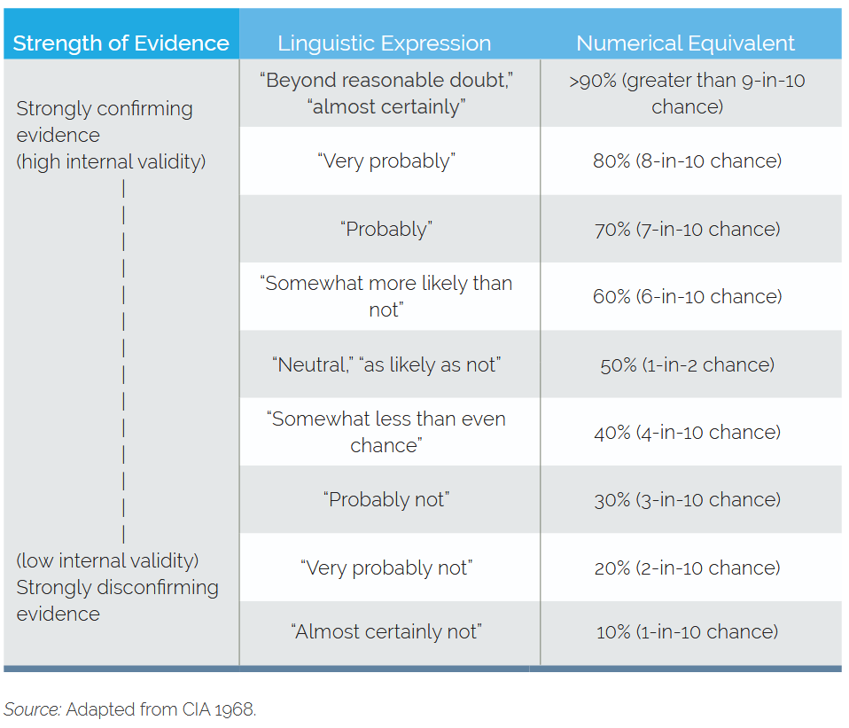
Source: Beach, Derek, and Estelle Raimondo. 2025. Process-Tracing Methods in Program Evaluation. IEG Methods and Evaluation Capacity Development Working Paper Series. Independent Evaluation Group. World Bank

Slide 21
Steps in Process Tracing: Lessons from cases
Descriptive analysis of what happened, identifying what activities were associated with the intervention and what potential contributions to the final policy or program outcome each activity might have produced;
Initial exploration of how each contribution to the final outcome might have been plausibly produced, including identification of key episodes;
Disaggregation of the pToC into episodes of interaction between actors.
Source: Beach, Derek, and Estelle Raimondo. 2025. Process-Tracing Methods in Program Evaluation. IEG Methods and Evaluation Capacity Development Working Paper Series. Independent Evaluation Group. World Bank

Slide 22
Example

Slide 23
Example: reduction of administrative burden
CHALLENGES OR BARRIERS
Funding, resources, successful IT project, engagement of final users
INTERVENTION
Programme evaluation
Recommendation:
Improvement of electronic application system to reduce administrative burden of the beneficiaries
DESK OFFICER OF THE MANAGING AUTHORITY
Reads the evaluation report and discusses the findings
HEAD OF MANAGING AUTHORITY
Decides to start a project for developing the electronic application system. Decides on funding.
IT CONTRACTORS
Improve the electronic application system. A 6-month development project is started. Feedback from final users (=beneficiaries) is sought in the process.
DESK OFFICER OF THE MANAGING AUTHORITY
Writes guidance on the updated electronic application system and communicates the changes to the beneficiaries.
CONTRIBUTION
The system becomes easier and faster to use, which reduces the administrative burden for the beneficiaries
CONTEXTUAL CONDITIONS
Enthusiastic desk officer, Head of MA interested in reducing administrative burden

Slide 24
Excercise
Work on the basis of the case we worked on in the previous exercises
TASKS
Define the change process to be examined
Develop a Process Theory of Change
Establish the evidence (consider the tests!)
What would prove / disprove the causality?
Plan data and information collection
What kind of data/information would be collected?

Slide 25
Source: Beach, D., and Raimondo, E. 2025. Process-Tracing Methods in Program Evaluation. IEG Methods and Evaluation Capacity Development Working Paper Series. Independent Evaluation Group. World Bank

Slide 26
Further Reading
Beach, Derek, and Estelle Raimondo. 2025. Process-Tracing Methods in Program Evaluation. IEG Methods and Evaluation Capacity Development Working Paper Series. Independent Evaluation Group. World Bank. https://ieg.worldbankgroup.org/sites/default/files/Data/Evaluation/files/report-methods-Process_Tracing.pdf
Ricks JI, Liu AH. Process-Tracing Research Designs: A Practical Guide. PS: Political Science & Politics. 2018;51(4):842-846. doi:10.1017/S1049096518000975
Bennett, A (2010). “Process Tracing and Causal Inference.” In Rethinking Social Inquiry: Diverse Tools, Shared Standards, 2nd ed., ed. Henry E Brady and David Collier, 207–19. Lanham, MD. Rowman and Littlefield.
Collier, D (2011). Understandig Process Tracing. Political Science and Politics 44(4):823-830.
Falleti, T (2006). ‘Theory-guided Process Tracing in Comparative Politics: Something old, something new’. APSA-CP: Newsletter of the American Political Science Association 17.1: 9–14.
George, A and Bennett, A (2005). Case Studies and Theory Development in the Social Sciences. (Belfer Center Studies in International Security). The MIT Press.
Oxfam (2011). Process Tracing: Draft protocol. Oxfam GB.
Punton, M and Welle, K (2015). Straws-in-the-wind, Hoops and Smoking Guns: What can process tracing offer to impact evaluation? IDS CDI Practice Paper, No. 10, 2015.

