Slide 1




Final Management Committee (MC) meeting
PROFEEDBACK Cost Action CA20112
Gábor Balás
Chair of PROFEEDBACK Cost Action
Director of HÉTFA Research Institute

Slide 2
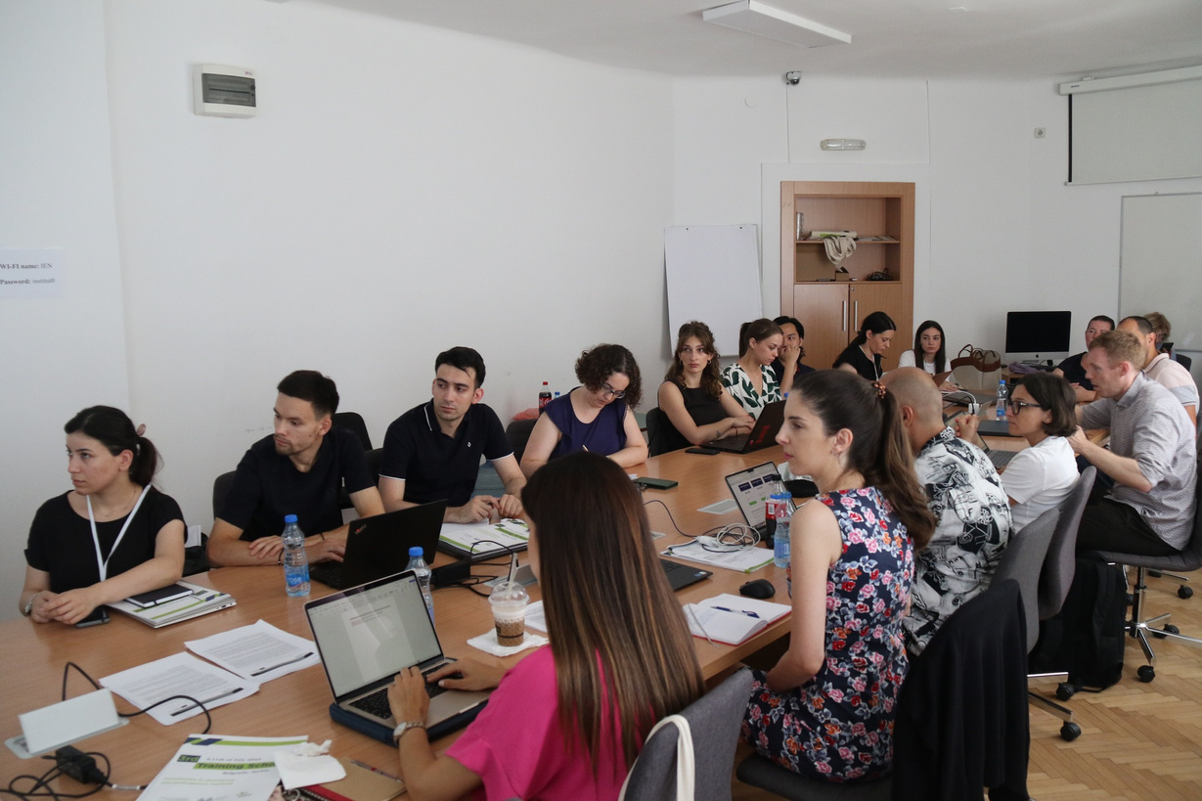
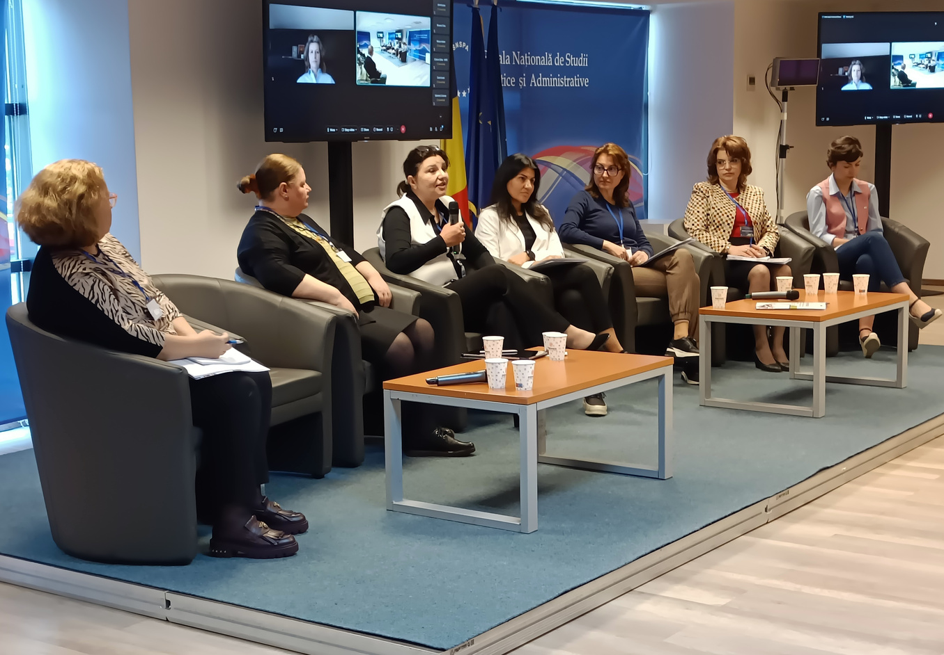
WELCOME

Slide 3

Why are we gathered today?
1 NOV 2023 -
31 OCT 2024
1 NOV 2024 -
17 OCT 2025
GRANT PERIOD 3
GRANT PERIOD 4
1 NOV 2022 -
31 OCT 2023
18 OCT 2021 -
31 OCT 2022
GRANT PERIOD 2
GRANT PERIOD 1
www.profeedback.eu • www.cost.eu • www.hetfa.eu
www.profeedback.eu • www.cost.eu • www.hetfa.eu

Slide 4
Purpose of the meeting
To sum up and discuss:
What we have done
What we have achieved
What future activities will sustain our result
www.profeedback.eu • www.cost.eu • www.hetfa.eu
www.profeedback.eu • www.cost.eu • www.hetfa.eu

Slide 5
Agenda
10:00-10:05 Opening
10:05-10:20 General overwiev of the Action
10:20-10:50 Working group reports
10:50-11:20 Discussion and Q&A
11:20-11:30 Closing Session
www.profeedback.eu • www.cost.eu • www.hetfa.eu
www.profeedback.eu • www.cost.eu • www.hetfa.eu

Slide 6
General Overview
www.profeedback.eu • www.cost.eu • www.hetfa.eu
www.profeedback.eu • www.cost.eu • www.hetfa.eu

Slide 7
Aims and Goals of PROFEEDBACK Cost Action
www.profeedback.eu • www.cost.eu • www.hetfa.eu
www.profeedback.eu • www.cost.eu • www.hetfa.eu

Slide 8
What did we aim for the in the MoU?
In the Memorandum of Understanding we aimed
to foster the networking of the policy evaluation community at EU-level,
to raise awareness on the importance of evaluation policy research to improve its impact on policy-making.
www.profeedback.eu • www.cost.eu • www.hetfa.eu
www.profeedback.eu • www.cost.eu • www.hetfa.eu

Slide 9
Main goals of PROFEEDBACK Cost Action
facilitate knowledge sharing on policies and policy evaluation among stakeholders
  bring together both European and national, as well as policy and evaluation experts in the field
  offer a platform for sharing insights, research findings, and best practices empower government officials and stakeholders to make more informed decisions regarding the design and implementation of policies and funds
  increase in the efficiency and effectiveness of policies by providing better evaluation information
www.profeedback.eu • www.cost.eu • www.hetfa.eu
www.profeedback.eu • www.cost.eu • www.hetfa.eu

Slide 10
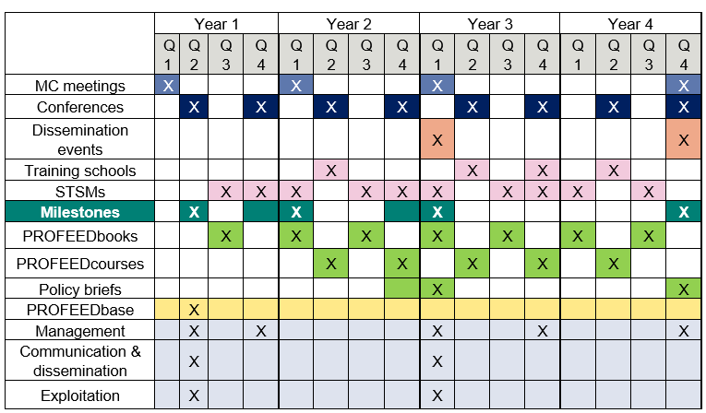
What tools did we use to achieve our goals?
What we planned in the first MC meeting (18.10.2021)?
www.profeedback.eu • www.cost.eu • www.hetfa.eu
www.profeedback.eu • www.cost.eu • www.hetfa.eu

Slide 11
We fulfilled our commitments and even exceeded them in several areas
www.profeedback.eu • www.cost.eu • www.hetfa.eu
www.profeedback.eu • www.cost.eu • www.hetfa.eu

Slide 12
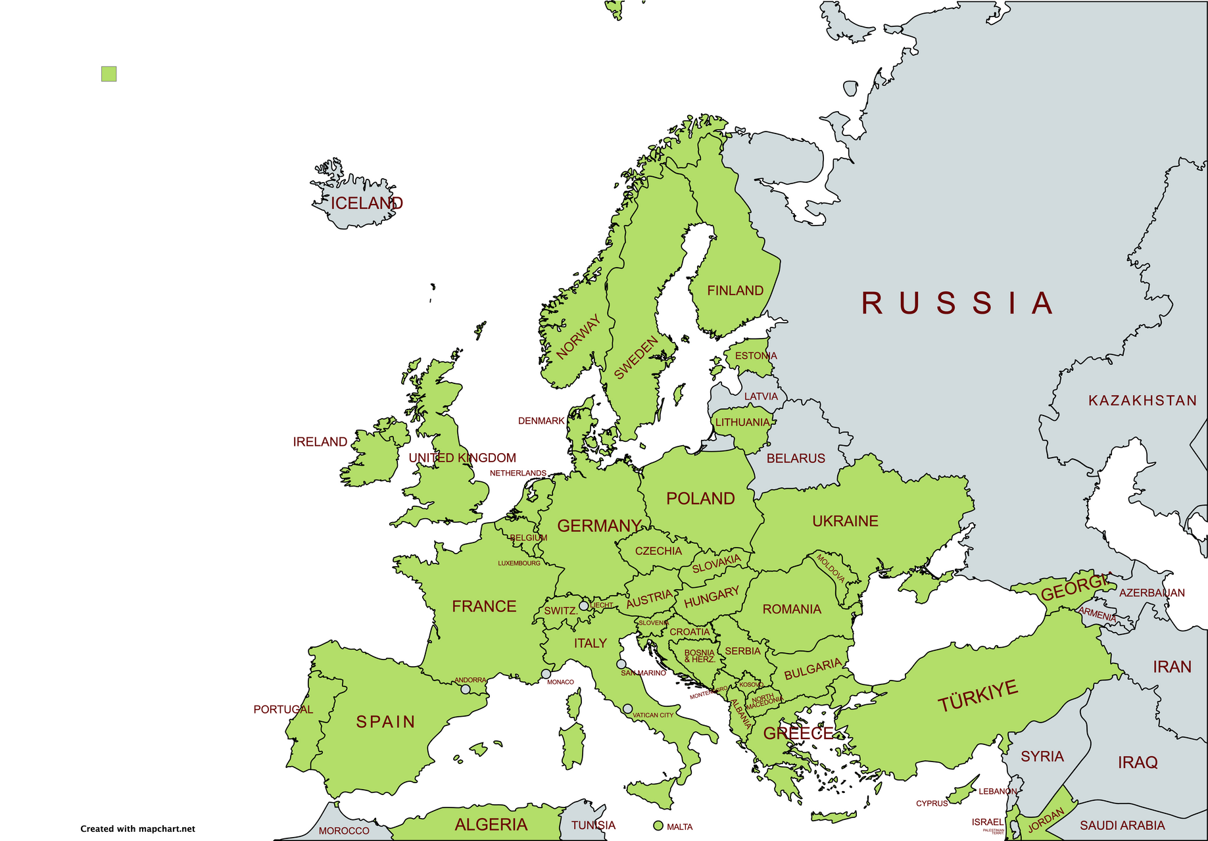
Building network - Members of PROFEEDBACK
294 researcher and policy evaluator (48 new member in GP4)
from 44 countries
(incl. Brazil and Canada)
162 female reseacher
117 young researcher
191 members from ITC countries
www.profeedback.eu • www.cost.eu • www.hetfa.eu
www.profeedback.eu • www.cost.eu • www.hetfa.eu

Slide 13
Events for building networks - 1
  9 Conferences (planned 8):
    8 Cities
    More than 350 presentation
    More than 800 participant (gross number)
    2 co-organized conference (Belgrade, Vienna)
    in GP4:
      8th PROFEEDBACK Conference on Research, Innovation and Digitalization Cooperation with the REvaluation Conference - Vienna, Austria
      9th PROFEEDBACK Conference on Public Education and Youth Policy - Budapest, Hungary
www.profeedback.eu • www.cost.eu • www.hetfa.eu
www.profeedback.eu • www.cost.eu • www.hetfa.eu

Slide 14
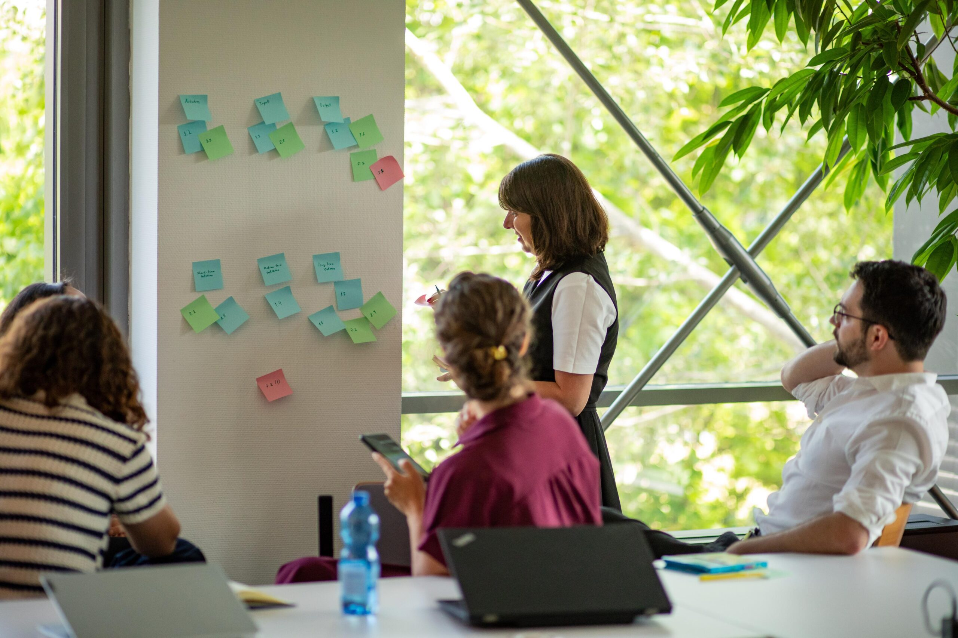
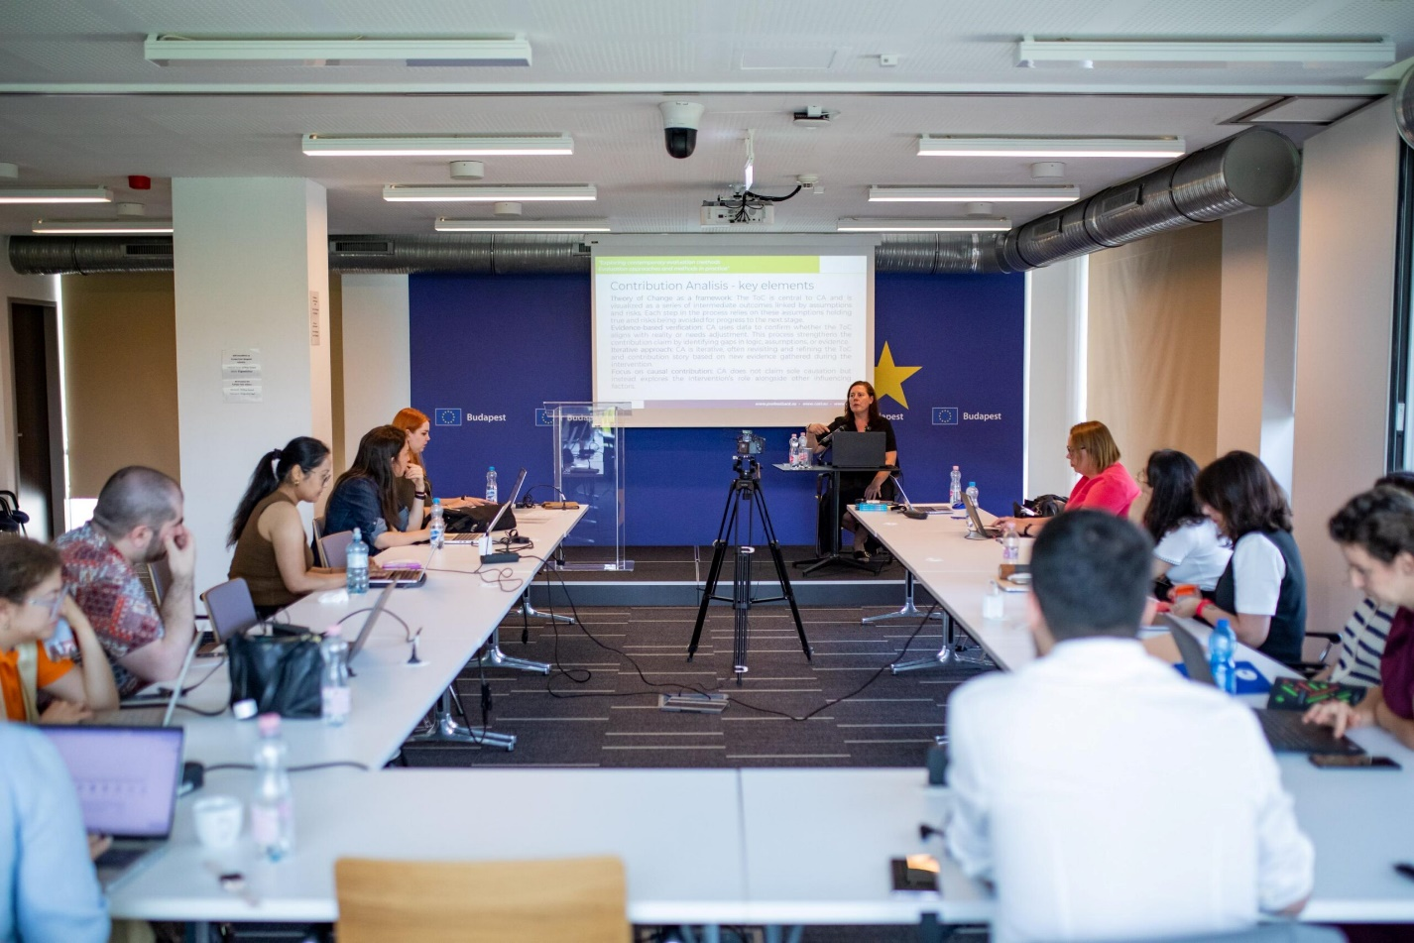
Events for building networks - 2
  4 Training schools for young researchers:
    4 cities
    48 young researcher
    In GP4: 4th PROFEEDBACK Training School on Exploring contemporary evaluation methods - Budapest, Hungary
www.profeedback.eu • www.cost.eu • www.hetfa.eu
www.profeedback.eu • www.cost.eu • www.hetfa.eu

Slide 15
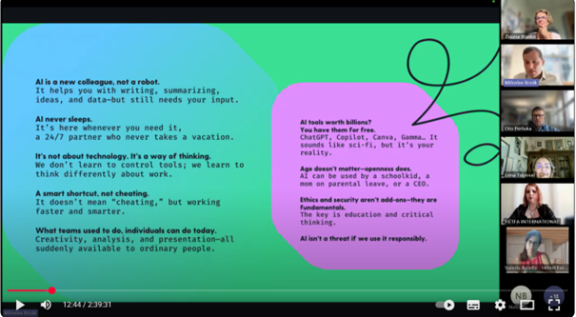
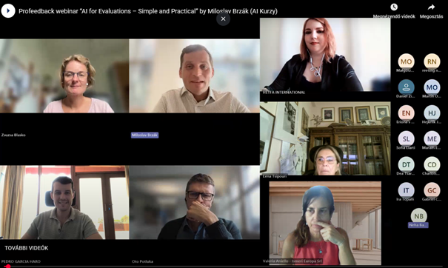
Events for building networks - 3
  5 dissemination event (planned 2)
    In GP4:
      Online workshop on Qualitative approaches in policy evaluations: Insight from Ukraine, Serbia and Lithuania
      Online webinar AI for Evaluation: What it can do for you
      Online webinar on Integrating Gender and Intersecionality in Research and Projects
  WG meetings and discussions
www.profeedback.eu • www.cost.eu • www.hetfa.eu
www.profeedback.eu • www.cost.eu • www.hetfa.eu

Slide 16
Grants for building cooperation among members and sharing our knowledge
  18 intra PROFEEDBACK cooperation facilitated by STSM grants:
    GP4: 4
  8 ITC grant for young researchers
    GP4: 4
  14 Dissemination Grant for senior researchers:
    GP4: 7
www.profeedback.eu • www.cost.eu • www.hetfa.eu
www.profeedback.eu • www.cost.eu • www.hetfa.eu

Slide 17


Knowledge sharing to raise awareness on policy evaluation issues
  9 PROFEEDBOOKS on the conference
    In GP4: 2
  8 ProfeedCourse about the knowledge of training schools and webinars:
    In GP4: 4
  15 Policy briefs (planned 2):
    In GP4: 7
www.profeedback.eu • www.cost.eu • www.hetfa.eu
www.profeedback.eu • www.cost.eu • www.hetfa.eu

Slide 18
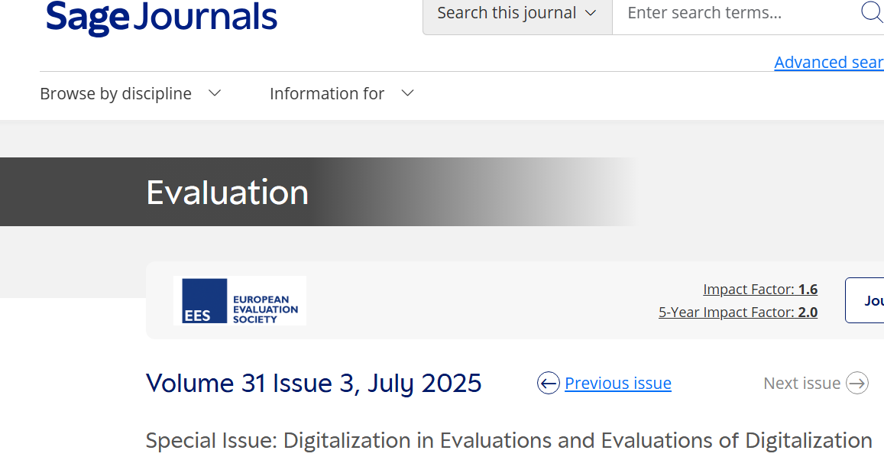
Knowledge sharing to raise awareness on policy evaluation issues - 2
  Publications facilitated by PROFEEDBACK network building:
    <18 (data are under collection)
  2 Special issues:
    Digitalization in evaluations and evaluations of digitalization in Evaluation Vol 31. Issue 3.
    On Quality of Life in Calitatea Vietii Vol 36 No.3
www.profeedback.eu • www.cost.eu • www.hetfa.eu
www.profeedback.eu • www.cost.eu • www.hetfa.eu

Slide 19
Sustainability and future activities
    We have fulfilled our commitments, but the main question is what kind of projects our cooperation can continue to thrive in.
www.profeedback.eu • www.cost.eu • www.hetfa.eu
www.profeedback.eu • www.cost.eu • www.hetfa.eu

Slide 20
Thank you!
Gábor BALÁS
Director of HÉTFA Research Institute
Chair of PROFEEDBACK COST Action

Slide 21






GET IN TOUCH
profeedback@hetfa.hu
www.profeedback.eu

